Slide 1



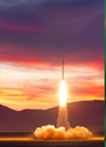
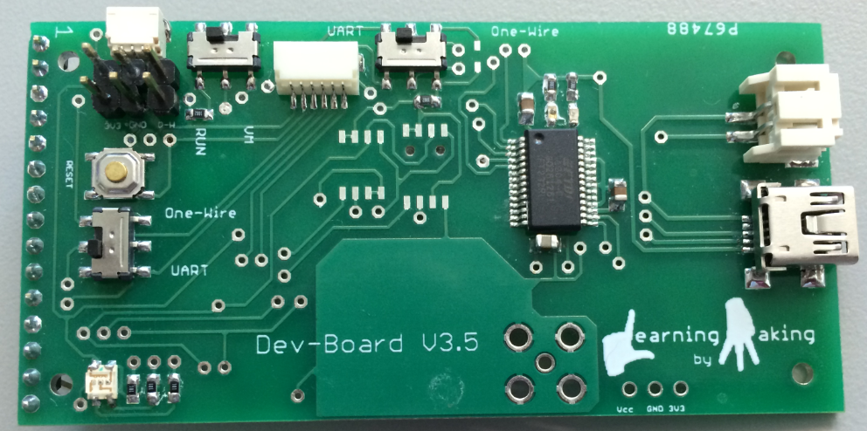
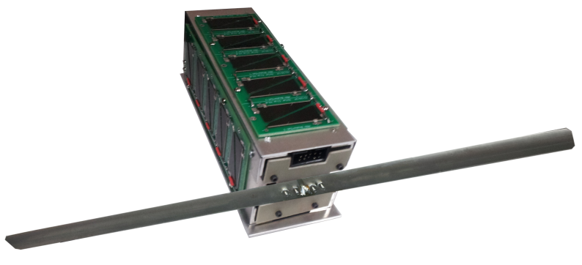


Rockets, Satellites and More!
Prof. Lynn Cominsky Education and Public Outreach Sonoma State University

Slide 2

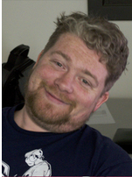
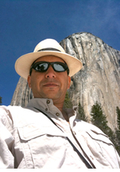
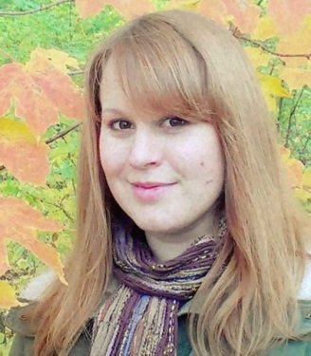
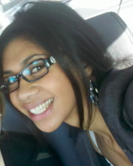
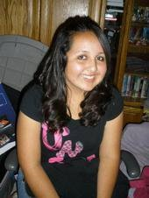
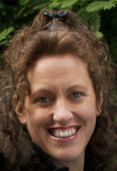
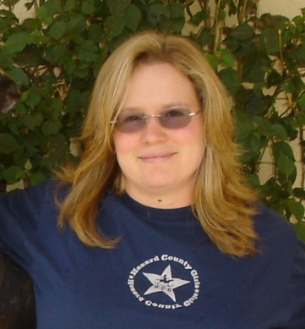
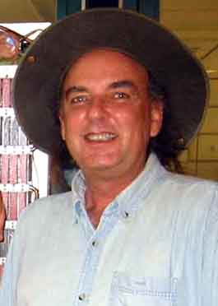
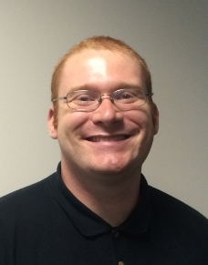
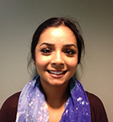
Kevin John
Instructional Technology
Dr. Kevin McLin
GTN Director
Dr. Carolyn Peruta
Education Support Scientist
Alyssa Afa’ese
Student Assistant – EE
Juanita Tenorio
Student Assistant – Business
Aurore Simonnet
Scientific Illustrator
Laura Chase
Project Support Coordinator
David McCall
Systems Administrator
Hunter Mills
Support Staff
Amandeep Gill
Student Assistant – Physics
Our mission is to develop exciting formal and informal educational materials to inspire students in grades 5-14 to pursue STEM careers, to train teachers nation-wide in the classroom use of these materials, and to enhance science literacy for the general public.

Slide 3
What do we do?
We support several different NASA high-energy astrophysics missions
We develop curriculum for middle → college students and train teachers
We run a robotic telescope at Pepperwood
In the past we have also worked on PBS Nova and planetarium shows, interactive web games, weekly webcomics and more
We build experiments and launch them!

Slide 4
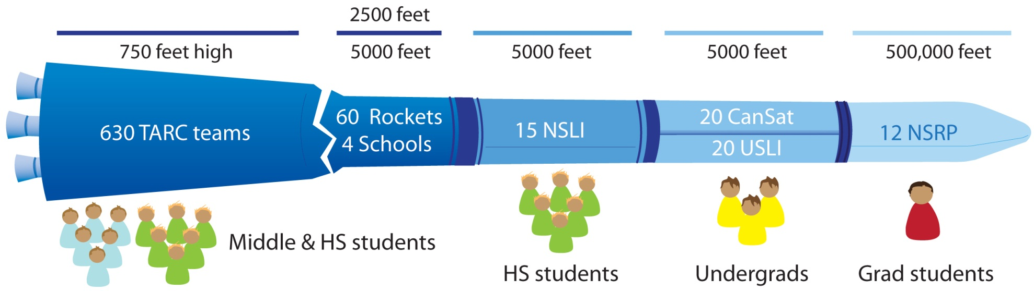
STEM Pipeline for rocketry

Slide 5
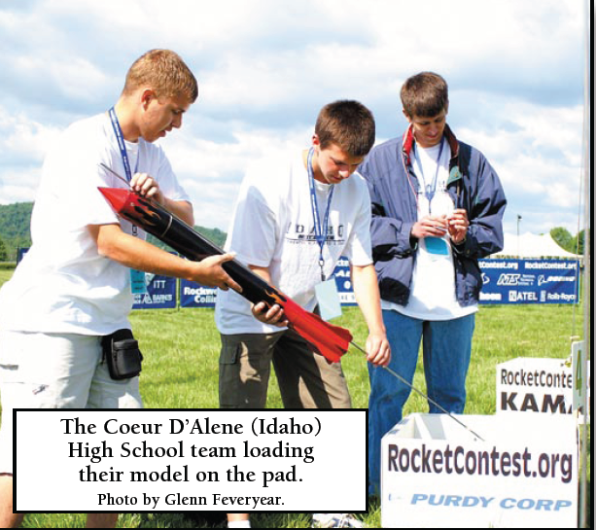
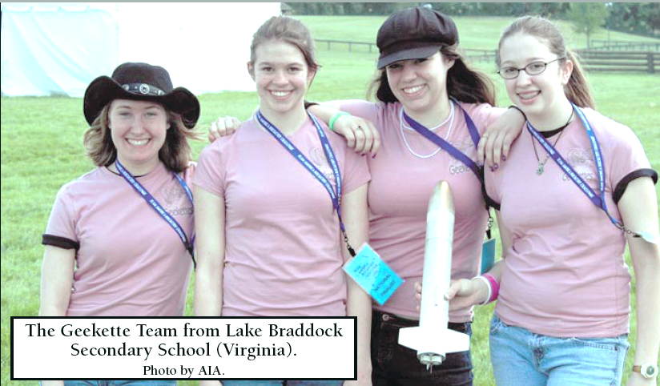
Team America Rocketry Challenge
About 7000 students nationwide
Model rockets that usually loft eggs to 500-750 feet and return them unbroken

Slide 6
Model vs. High Power Rocketry
Motors are rated by thrust in Newton-seconds
Each letter is a factor of 2 more thrust
Model rockets are ¼ A to G (160 N-s, max)
HP rocketry is H and above
Level 1 is H and I (640 N-s max)
Level 2 is J and K (2560 N-s max)
I am a Level 2 flyer (so is Kevin J.)

Slide 7
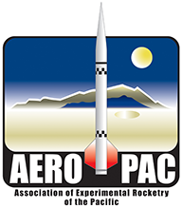

Meet the S4 partners
Association of Experimental Rocketry of the Pacific (AeroPac) – the Northern CA/Nevada chapter of the Tripoli Rocketry Association
Tony Alcocer – President
Ken Biba – Education Director
Endeavour Institute – Balloon Fests
Steve Kliewer, Director
We also partner with a few other rocket clubs: LUNAR (Livermore Unit of NAR) and ROC (Rocketry Organization of California) for launches
s4.sonoma.edu

Slide 8


High Powered Rocketry and YOU
Certification Process:
Level 1 – Build, fly and recover an airframe on an L1 motor
Level 2 – Build, fly and recover an airframe on an L2 motor and pass a written test
Level 3 - Build, fly and recover an airframe on an L3 motor using electronics
NAR Clubs:
Kansas:
Kansas City Association of Rocketry (KCAR)
De Soto High School Rocketry Club (DHS Rocketry Club)
Kansas Organization for Space Modeling
Oklahoma:
Piedmont Area Rocketry Club (PARC)
Red River Rocketeers (RRRS)
Tripoli Clubs in Kansas: Tripoli Kansas, Tripoli Mo-Kan
In Oklahoma: Tripoli Oklahoma, Tripoli Tulsa

Slide 9
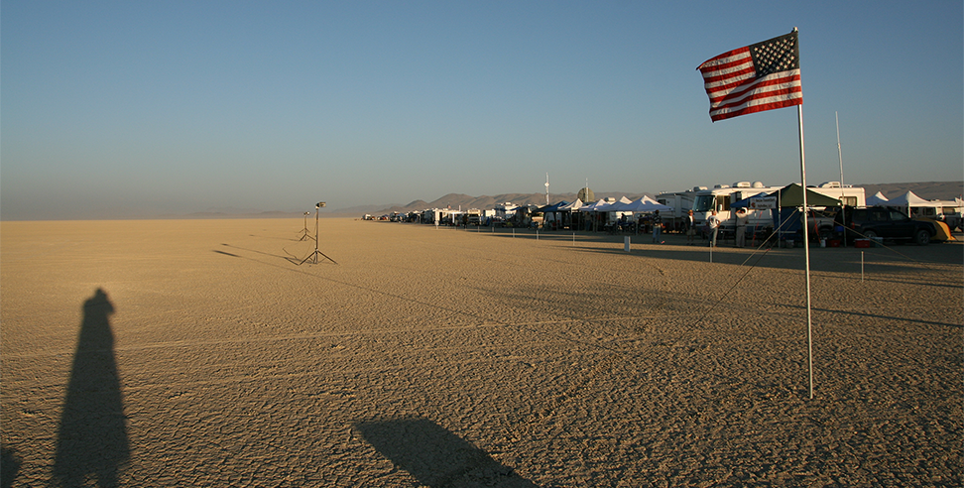
World’s Best Launch Site
AeroPAC: Black Rock Playa (200,000 ft limit)

Slide 10
ARLISS as the inspiration for S4
AeroPac and Bob Twiggs started A Rocket Launch for International Student Satellites (ARLISS) over 10 years ago
University students from across the globe come to the Black Rock playa to launch payloads which are ejected from the rockets
Mostly students from Japan, but also Korea, India, Turkey, and a few from the USA

Slide 11
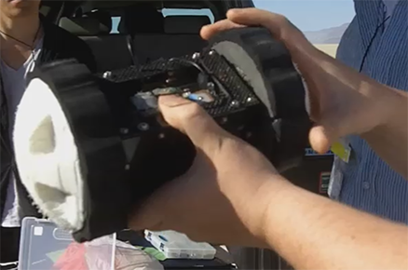
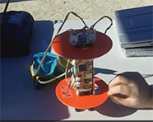
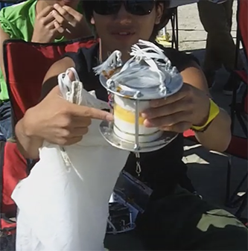
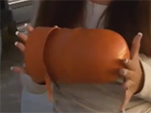
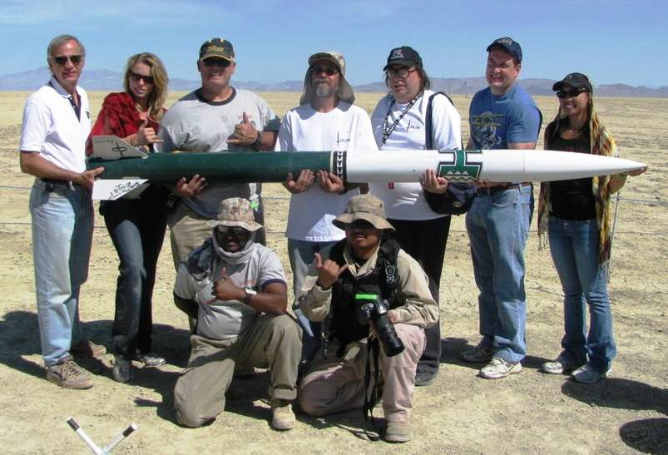
ARLISS
A Rocket Launch for International Student Satellites
Collaboration between engineering students and amateur rocket flyers
Various payload designs flown over the years include come-back rovers and scientific instruments
Black Rock Desert simulates harsh alien environments

Slide 12
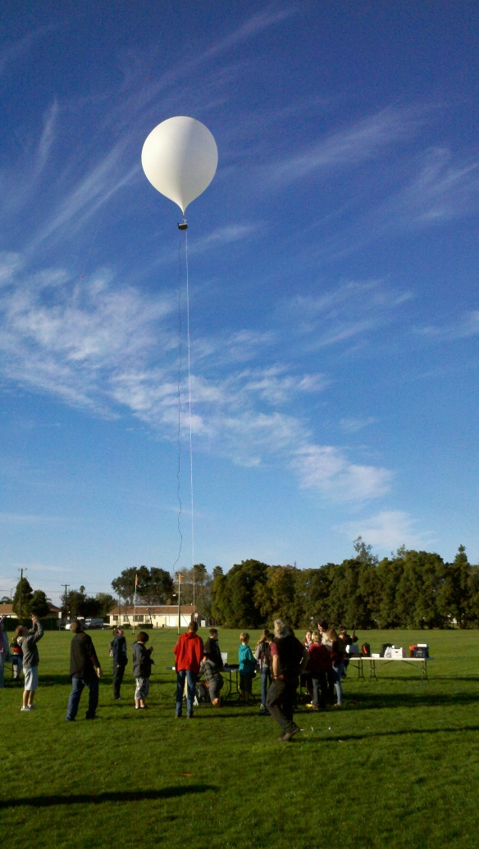
Tethered Balloons
Doesn’t require certification or complicated FAA clearance
Less expensive
Doesn’t require advanced equipment for telemetry
Less constraints on payload size and weight
Can be flown tethered to 1,000 feet or untethered
Greater control over altitude
Much longer time series for data

Slide 13
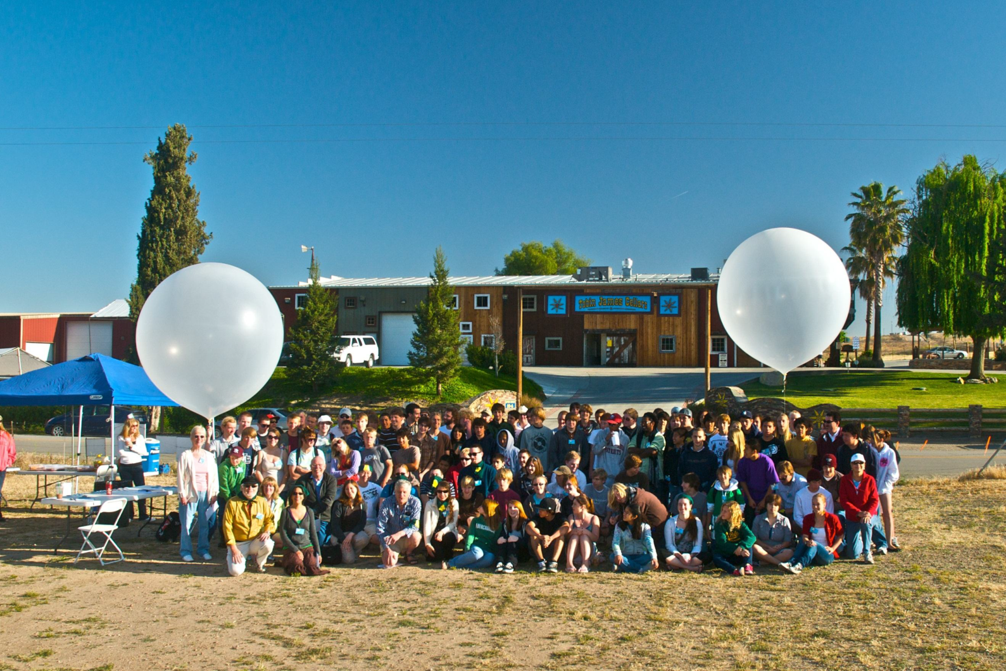
Balloonfest 2013
Tobin James Cellars, Paso Robles, Ca

Slide 14
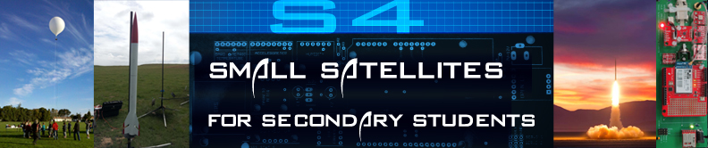
The S4 Project
For the past 3 years, the SSU team has been learning how to fly rockets and balloons, while designing the S4 flight electronics and software
We have designed a “flight board” which includes base components and optional sensors and have written an educator guide with background information, instructions and additional resources.
Last summer, we trained a group of teachers to build these payloads and launched them at Lucerne dry lakebed in Southern California
This year, the teachers are building S4 payloads with their middle & high-school students and flying them on rockets or tethered balloons

Slide 15
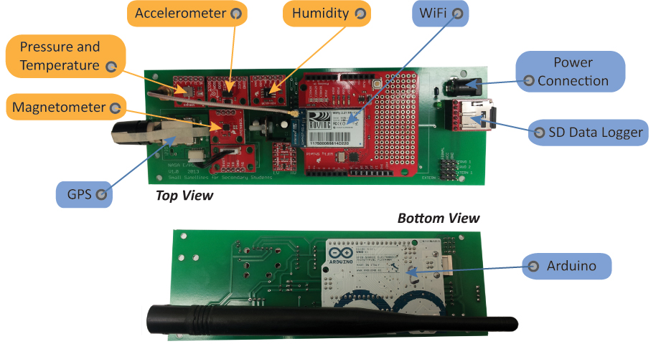
S4 Payload

Slide 16
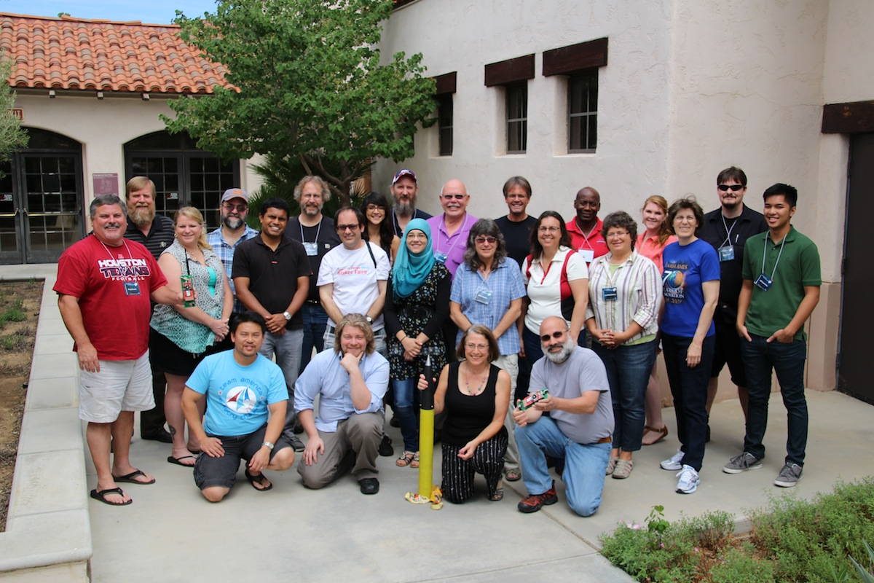
S4 Teacher Training – July 2013
Aero Institute, Palmdale Ca
18 educators from a diverse set of schools and other teaching organizations
Week long course
Built, tested and flew a prototype payload
Helped us refine our educational materials and the payload itself
Included talks from our partners and mentors

Slide 17
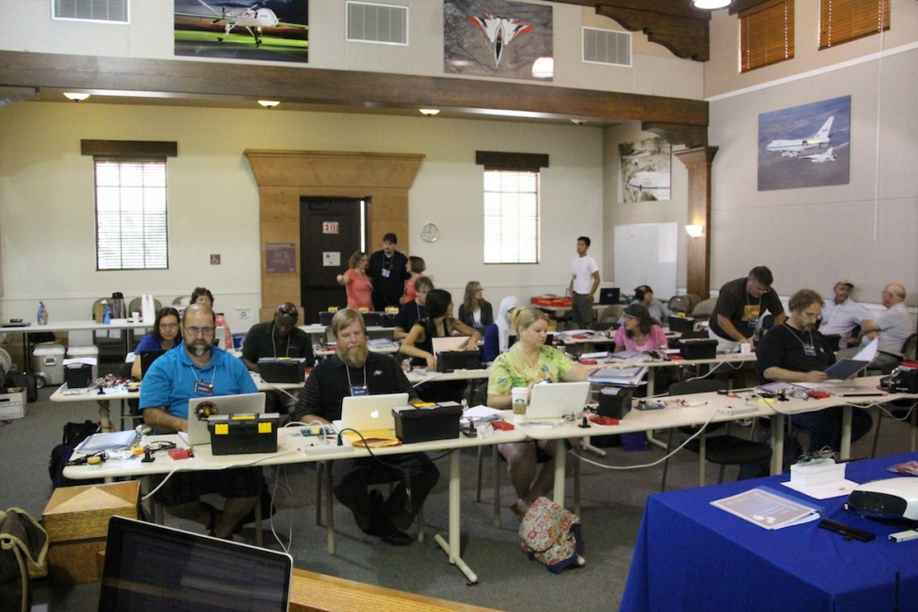
The first two days were spent learning the basics of electronics and soldering which were then put to use in constructing the flight board.

Slide 18
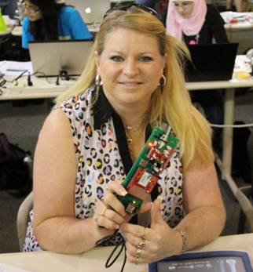
Beth Hill, Lawrence Jones Middle School
Once the flight board was finished the educators were introduced to programming in Arduino’s Processing language. They were then able to upload the programs to the payload after which they installed the sensors onto the flight board and finalized the payload.

Slide 19
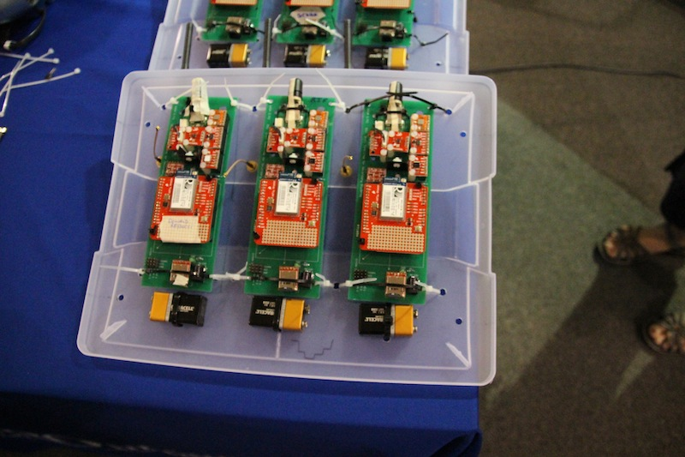
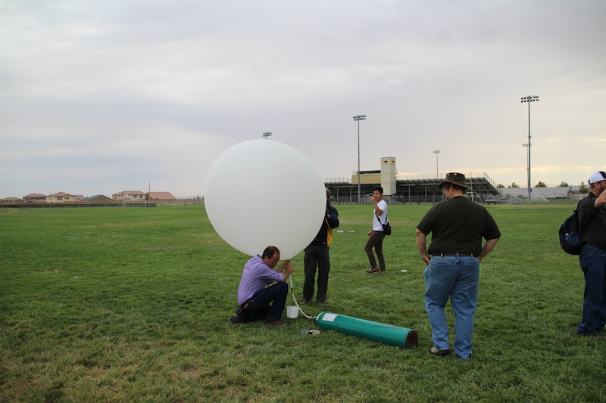
On Thursday the educators took their payloads out to a local high school’s fields. They readied their payloads for tethered helium balloon flights, three-to-a-gondola, as dark storm clouds were approaching.
Once a helium balloon was filled and tethered the winds really kicked up and it began to rain.
With the weather too chaotic to fly helium balloons, the educators took their payloads around the high school on foot in order to get data.

Slide 20
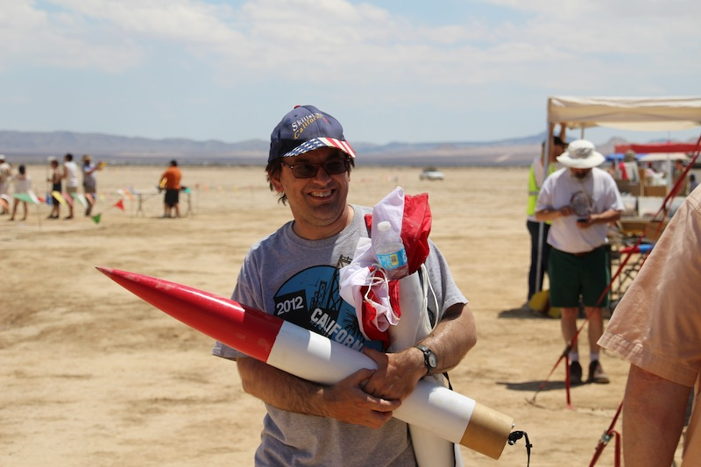
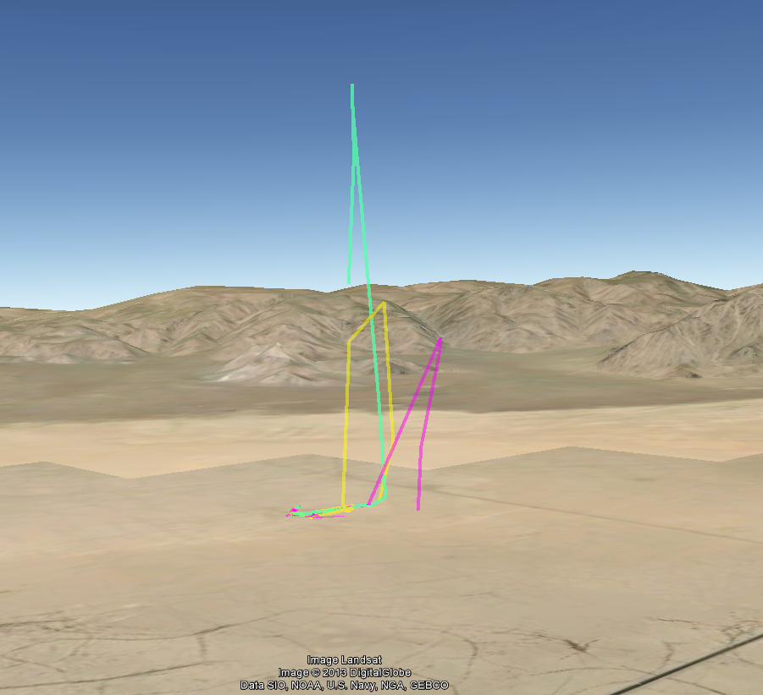
On Saturday the training was shifted to the Lucerne dry lake bed about 70 miles east of Palmdale. There, the payloads were flown on 3 and 4 inch diameter rockets to altitudes as high as 1828.1m (6000 feet) with on-site routers taking live data of each launch.
The bottom figure shows our three highest flight paths, as determined by the GPS chips on board.
Donald Repucci, Morro Bay

Slide 21
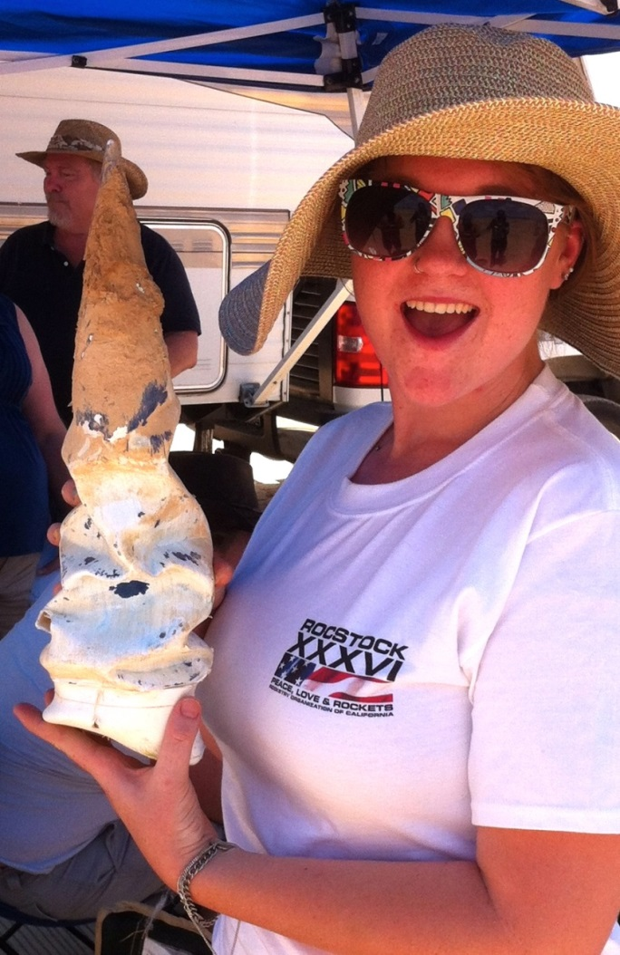
Everything thing went perfectly…
Nose cone from “lawn dart” rocket
…right up until the last flight

Slide 22
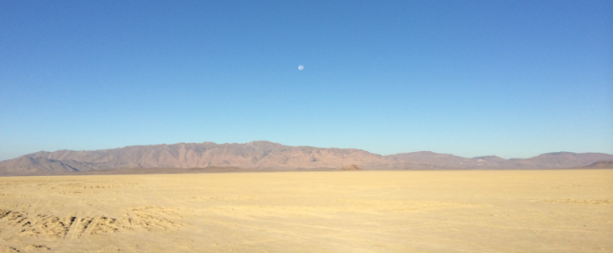
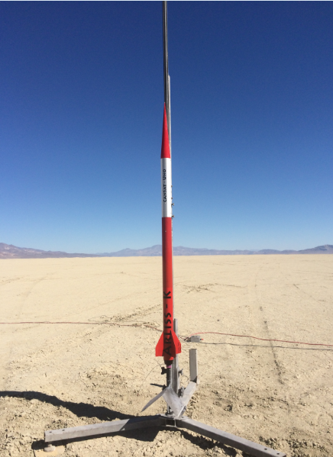
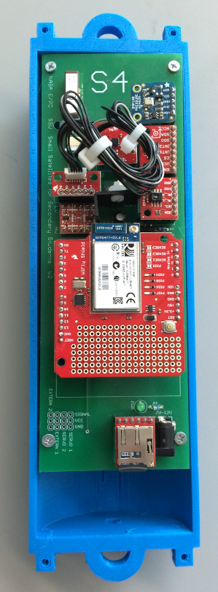
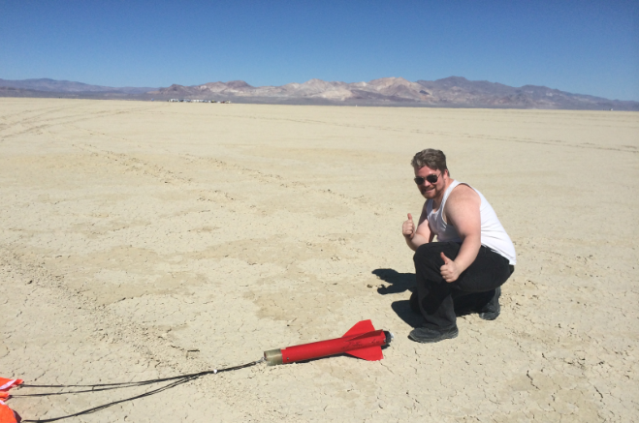
This year at Black Rock
S4 payload tests in 3D printed canister with ARLISS-K rocket to 8100 feet AGL

Slide 23
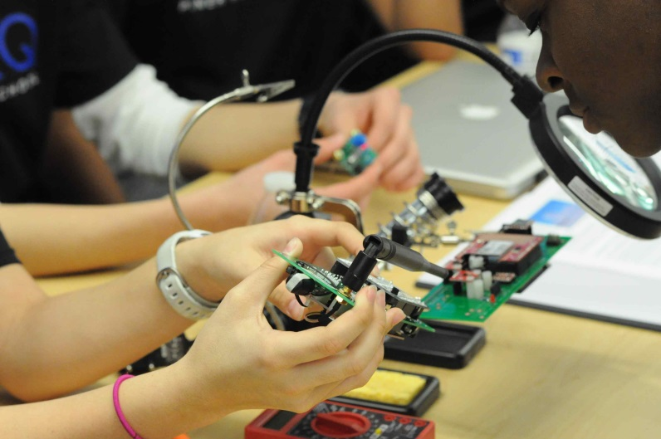
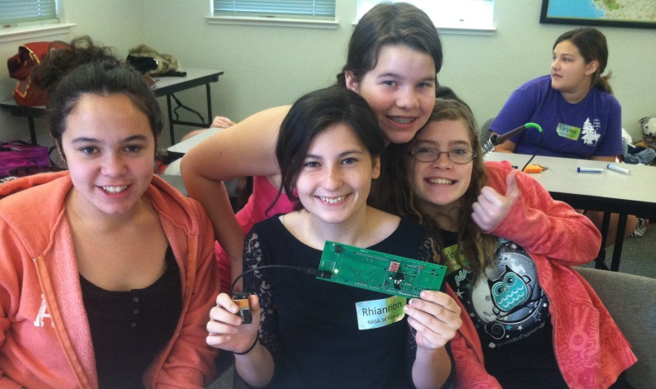
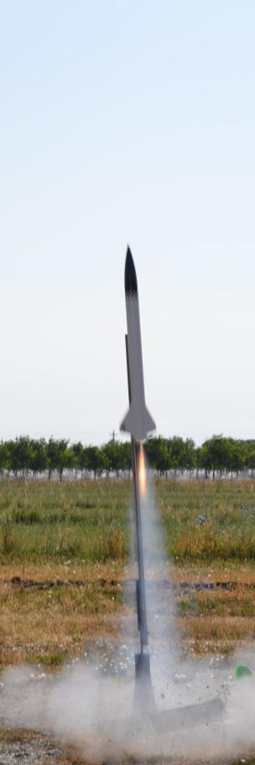
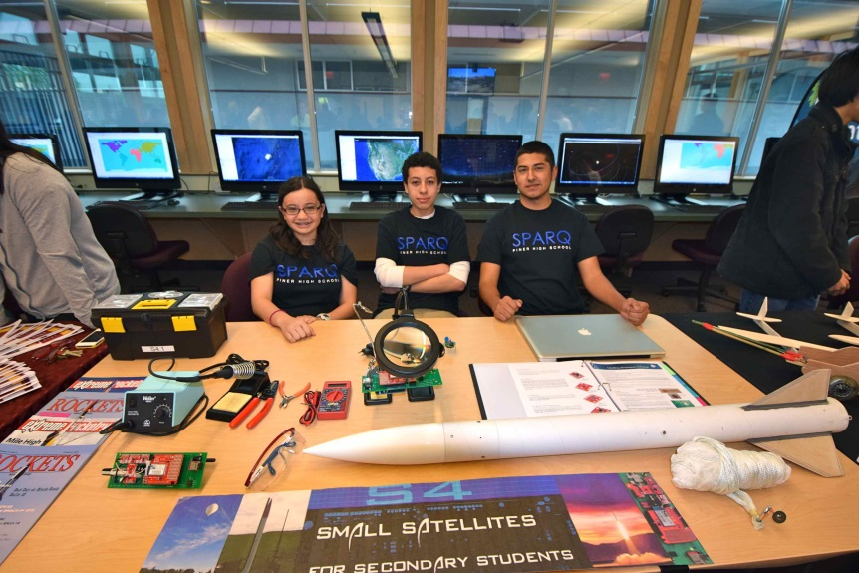
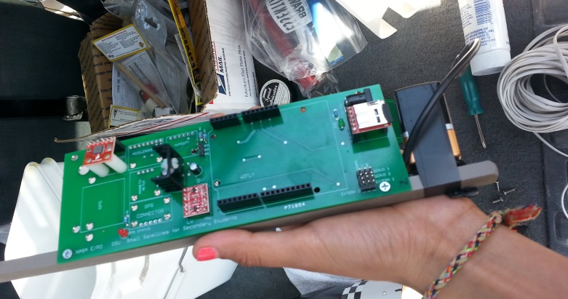
S4 in 2014
Student Payloads

Slide 24
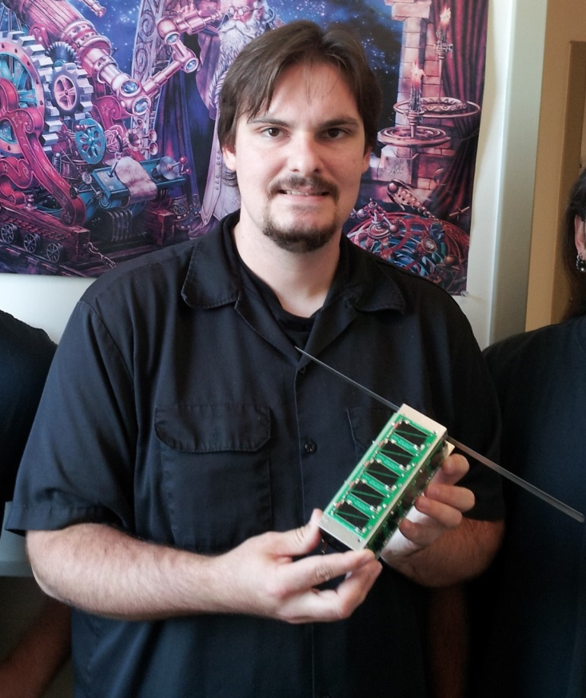
SSU students build and launch
PocketQube – Nov 2013
SSU student Kevin Zack designed the S4 board
He then started working on the PocketQube project
PocketQubes are smaller than traditional CubeSats
Our “3P” satellite was 15 x 5 x 5 cm & weighed about 0.5 kg
It was launched from Unisat-5, an Italian satellite that was launched from the Russian rocket Dnepr-1

Slide 25
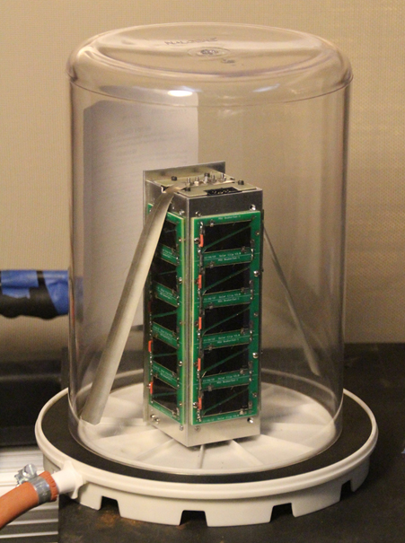
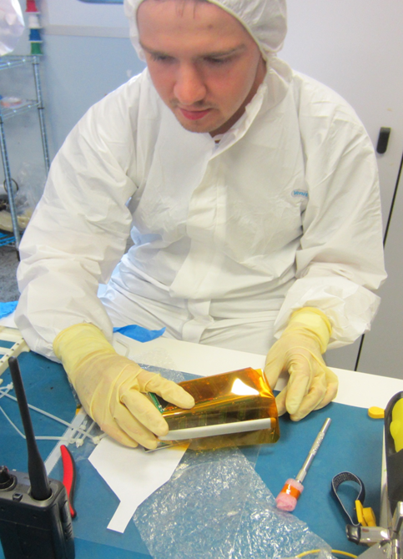
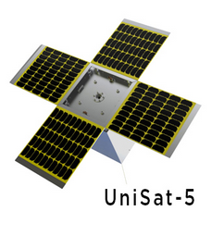
SSU Vacuum testing
Collaboration between SSU and Morehead State University
SSU provided the electronics
MSU provided the solar panels, structure and integration with Unisat-5
Sean McNeil (MSU) integrating with Unisat-5 in Italy
UniSat-5 launched several CubeSats and PocketQubes

Slide 26
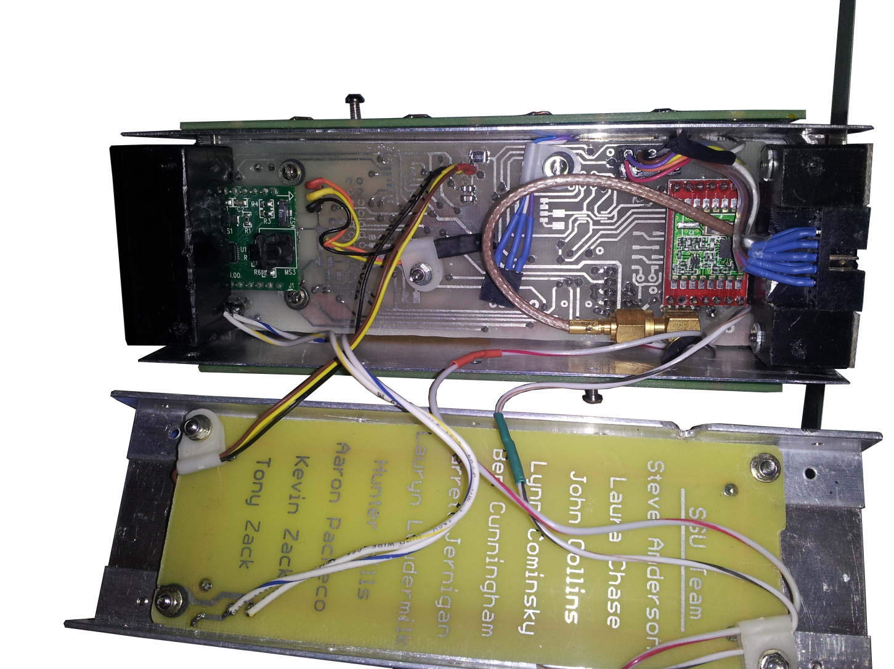
Inside T-LogoQube
Magnetometer
Radio
Torque Coils and name list

Slide 27
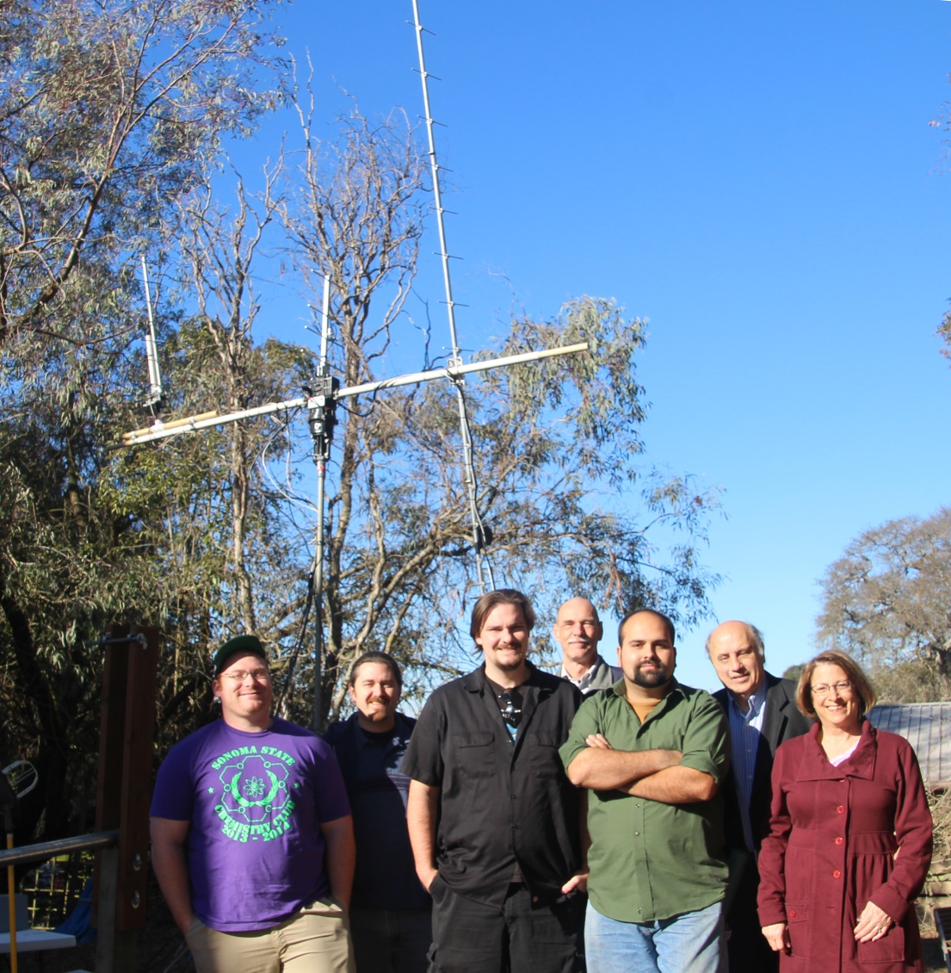

T-LogoQube team with Yagi antenna at the Little H-bar Ranch: L to R – Hunter Mills, Ben Cunningham, Kevin Zack, Steve Anderson, Aaron Pacheco, Garrett Jernigan and Lynn Cominsky
First packets detected using the Yagi antenna at 437.465 +- 0.012 MHz

Slide 28

Commanding T-LogoQube
Logo commands telling T-LogoQube to dump data during a pass over the Yagi antenna at the Little H-bar Ranch in Petaluma
Time
Frequency
TLQ lasted for two months and then fell victim to radiation due to its polar orbit

Slide 29

Next SSU CubeSats
TRL-6: Will be flying x-ray detector to raise the TRL to 6. It is a 1u-CubeSat to be launched from ISS in spring-summer 2015.
A³Sat: All female team of SSU students who are building a “flat-sat” to be tested in a high-altitude balloon flight. Then eventually we will try to arrange for a launch from ISS.
Alyssa, LRC, Anna, Aman, Carolyn Peruta

Slide 30

What is Learning by Making?
One of only 18 Investing in Innovation (i3) development projects awarded in 2013 by the U.S. Department of Education
Five-year program to develop engaging, hands on, project-based learning that integrates science and mathematics
Two new elective STEM courses:
Environmental Science/Biology
Chemistry/Physics

Slide 31

Innovations
Use of computational thinking to focus on real world problem solving
Solutions are constructed by teachers and students working together
Use of Logo programming language – overcomes barrier to learning how to code
Sensor based experiments that are networked
Simulations and modeling

Slide 32

Our goals
Develop two year-long integrated high school STEM courses that will be accepted as elective credit for university eligibility in California
Train at least half of the science and mathematics teachers in our partner schools to successfully deliver the curriculum
Improve math and science proficiency by 15% for students enrolled in the new courses.

Slide 33

First year overview
SSU is writing a Logo manual and building hardware platform prototype
Initial design of Environmental Science and Biology experiments and sensor selection and tests
Many visits with teachers to understand needs, infrastructure and how to successfully implement these ideas at the schools
Set up web-based infrastructure to allow real time communications with teachers

Slide 34

Prototype experiment

Slide 35




2014 Summer Institute

Slide 36
Connecting with AAPT-AOK
Anyone want to build an S4 payload? We will send you the board (for free!). Information on parts/WiFi software available at http://s4.sonoma.edu
Stay tuned for news about future CubeSat launches
University students can build radio antenna systems and listen to CubeSats – ask me how if you are interested
Learning by Making HS curriculum won’t be available for the public for at least two years. Sorry!
We have many other NASA-funded programs that I could not discuss tonight.
Especially “Big Ideas in Cosmology” online/hybrid college curriculum for GE students
Robotic Telescope accessible over the Internet through http://gtn.sonoma.edu

Slide 37

s4.sonoma.edu
universe.sonoma.edu/T-LogoQube
galaxy.sonoma.edu/i3
To see all our projects:
epo.sonoma.edu

