Slide 1

Building the STEM Pipeline with Rockets and CubeSats at Sonoma State University
Prof. Lynn Cominsky
SSU Education/Public Outreach and Department of Physics & Astronomy
This work has been supported by NASA Grant NNX12AB97G and California Space Grant

Slide 2
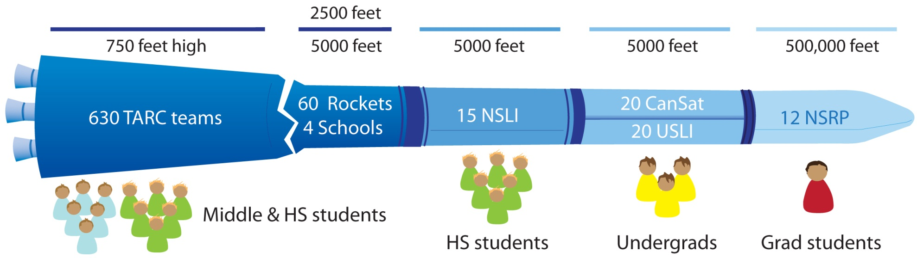
Broken Pipeline Problem

Slide 3
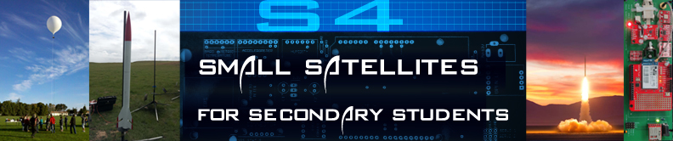
The S4 Project
For the past 3 years, the SSU team has been learning how to fly rockets and balloons, while designing the S4 flight electronics and software
We have designed a “flight board” which includes base components and optional sensors and have written an educator guide with background information, instructions and additional resources.
Last summer, we trained a group of teachers to build these payloads and launched them at Lucerne dry lakebed in Southern California
This year, the teachers are building S4 payloads with their middle & high-school students and flying them on rockets or tethered balloons

Slide 4


Meet the S4 partners
Association of Experimental Rocketry of the Pacific (AeroPac) – the Northern CA/Nevada chapter of the Tripoli Rocketry Association
  Tony Alcocer – President
  Ken Biba – Education Director
Endeavour Institute – Balloon Fests
  Steve Kliewer, Director
We also partner with a few other rocket clubs: LUNAR (Livermore Unit of NAR) and ROC (Rocketry Organization of California) for launches
s4.sonoma.edu

Slide 5
ARLISS as the inspiration for S4
AeroPac and Bob Twiggs started A Rocket Launch for International Student Satellites (ARLISS) over 10 years ago
University students from across the globe come to the Black Rock playa to launch payloads which are ejected from the rockets
Mostly students from Japan, but also Korea, India, Turkey, and a few from the USA

Slide 6
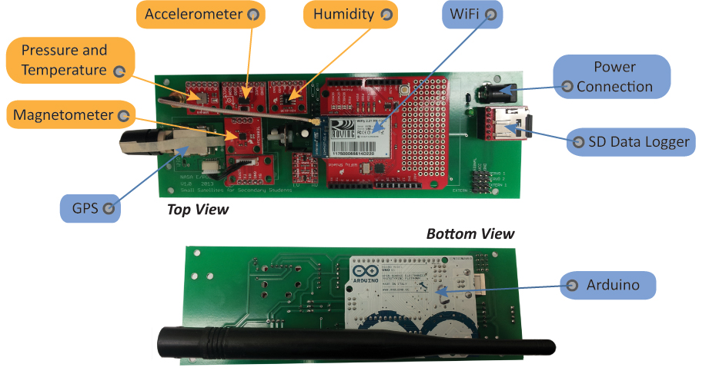
S4 Payload

Slide 7
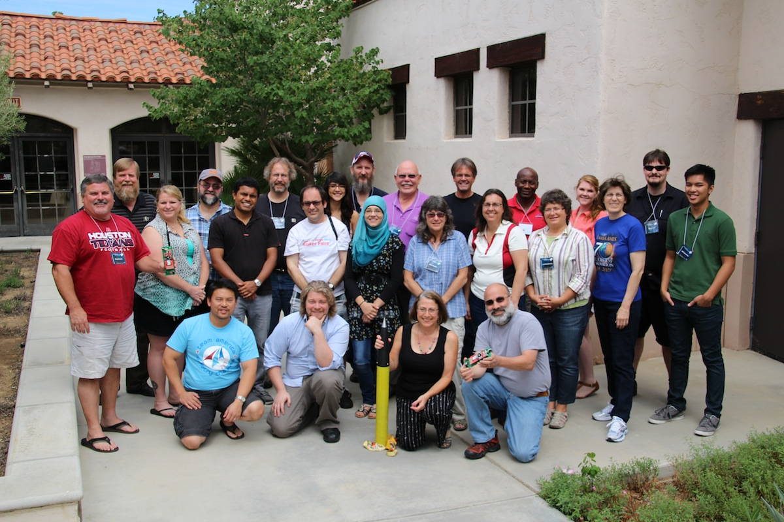
S4 Teacher Training – July 2013
Aero Institute, Palmdale Ca
18 educators from a diverse set of schools and other teaching organizations
Week long course
Built, tested and flew a prototype payload
Helped us refine our educational materials and the payload itself
Included talks from our partners and mentors

Slide 8
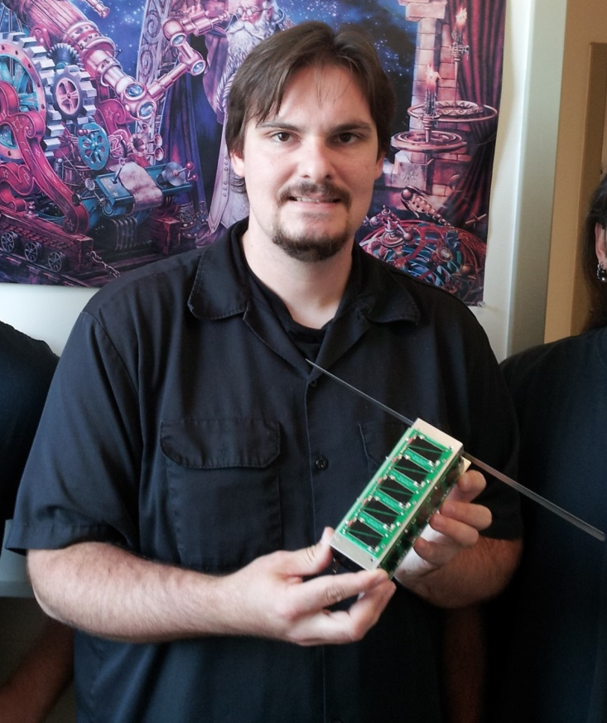
SSU students build and launch
PocketQube – Nov 2013
SSU student Kevin Zack designed the S4 board
He then started working on the PocketQube project
PocketQubes are smaller than traditional CubeSats
Our “3P” satellite was 15 x 5 x 5 cm & weighed about 0.5 kg
It was launched from Unisat-5, an Italian satellite that was launched from the Russian rocket Dnepr-1

Slide 9
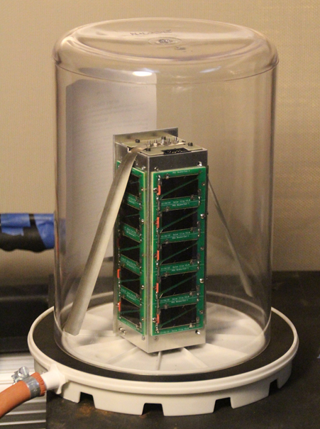
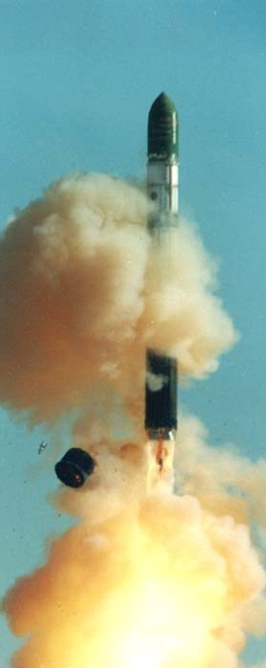
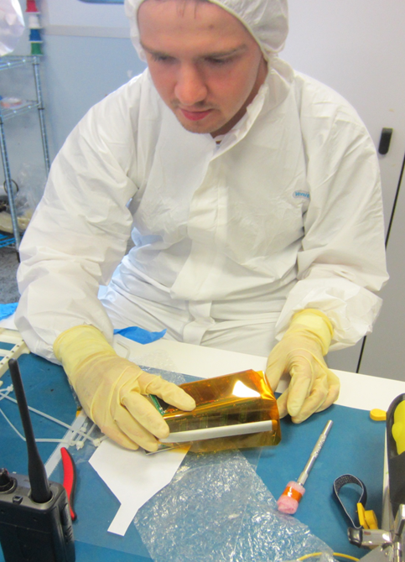
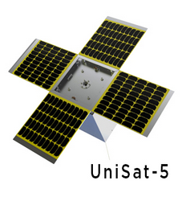
SSU Vacuum testing
Collaboration between SSU and Morehead State University
SSU provided the electronics
MSU provided the solar panels, structure and integration with Unisat-5
After launch on Russian Dnepr-1, we renamed the satellite
T-LogoQube
Sean McNeil (MSU) integrating with Unisat-5 in Italy
UniSat-5 launched several CubeSats and PocketQubes
Dnepr-1
http://universe.sonoma.edu/T-LogoQube

Slide 10
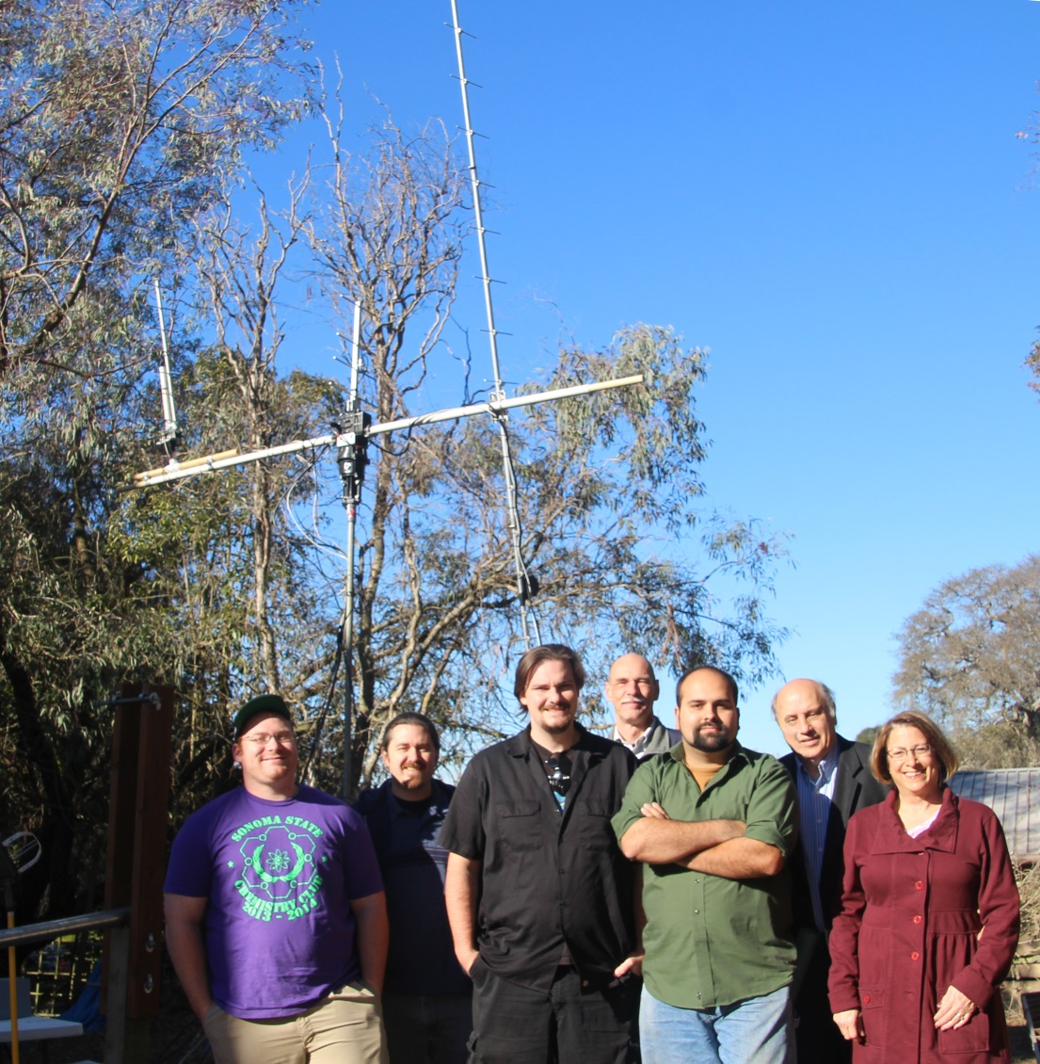
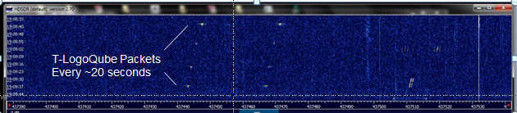
T-LogoQube team with Yagi antenna at the Little H-bar Ranch: L to R – Hunter Mills, Ben Cunningham, Kevin Zack, Steve Anderson, Aaron Pacheco (SRJC), Garrett Jernigan and Lynn Cominsky
First packets detected using the Yagi antenna at 437.465 +- 0.012 MHz

Slide 11
Next steps
Middle and high school students are building S4 payloads and flying them this spring and summer
SSU has partnered with NAR and AeroPac to offer S4 flights to up to 5 of the TARC finalists (since NSLI was cancelled for this year)
SSU students are working on next CubeSat – x-ray detector to be launched by Nanoracks from the ISS
SSU students have received partial funding from national SPS award to build Yagi antenna
California Space Grant funding hired 2 interns from local community colleges + 1 SSU student to work on the S4 and CubeSat projects this summer and to buy the rest of the parts for the new Yagi antenna
Formation of all female PocketQube team at SSU

Slide 12
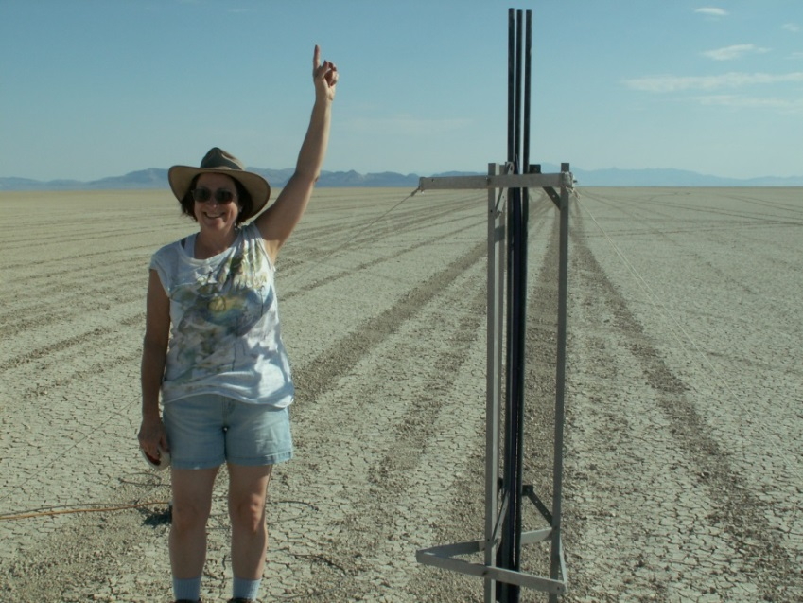
For more information about these projects visit:
s4.sonoma.edu
universe.sonoma.edu/T-LogoQube
To see all our projects:
epo.sonoma.edu

