Slide 1



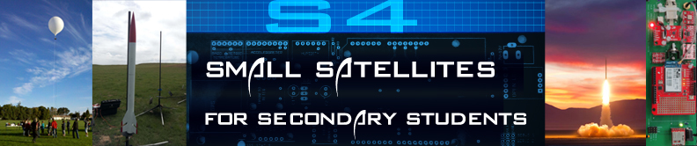
s4.sonoma.edu
Prof. Lynn Cominsky NASA Education/Public Outreach and Department of Physics & Astronomy
Sonoma State University
This work has been supported by NASA Grant NNX12AB97G

Slide 2

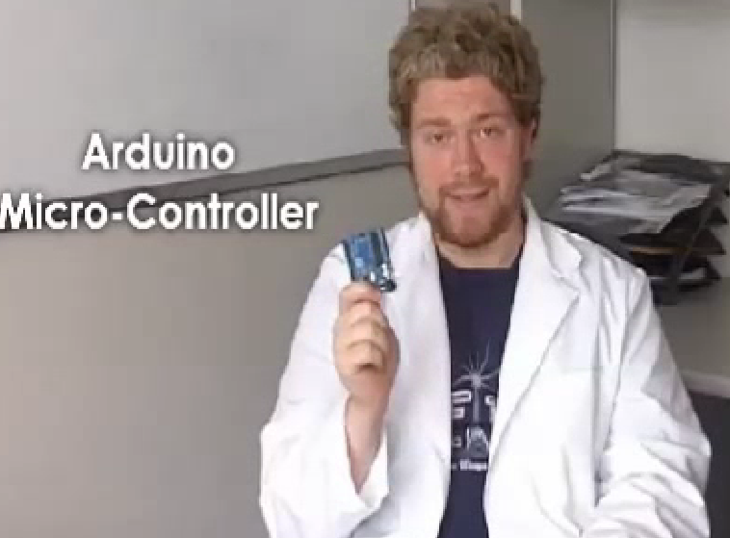
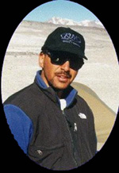
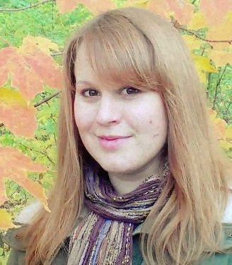
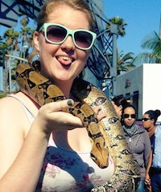
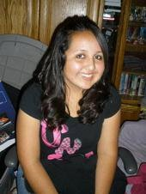
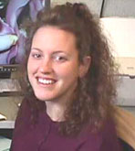
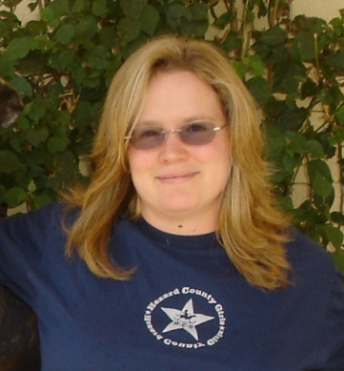
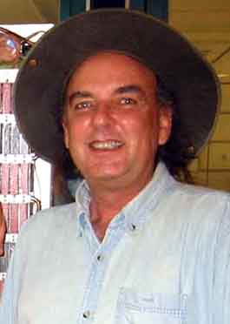
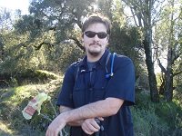
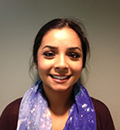
Kevin John
Instructional Technology
Dr. Kevin McLin
GTN Director
Dr. Carolyn Peruta
Education Support Scientist
Lauryn Loudermilk
Student Assistant – CS
Juanita Tenorio
Student Assistant – Business
Aurore Simonnet
Scientific Illustrator
Laura Chase
Project Support Coordinator
David McCall
Systems Administrator
Kevin Zack
Student Assistant – Physics
Amandeep Gill
Student Assistant – Physics
We support several different NASA Space Science missions, and are currently developing an online college curriculum in Cosmology. Our mission is to develop exciting formal and informal educational materials that use high-energy space science as a means to inspire students in grades 5-14 to pursue STEM careers, to train teachers nation-wide in the classroom use of these materials, and to enhance science literacy for the general public.

Slide 3
What do we do?
The mission of the SSU E/PO group is to develop exciting formal and informal educational materials to inspire students in grades 5-14 to pursue STEM careers, to train teachers nation-wide in the classroom use of these materials, and to enhance science literacy for the general public.
The S4 project is our newest curriculum development project, in partnership with AeroPAC, Endeavour Institute and NASA Dryden’s Aero Institute

Slide 4
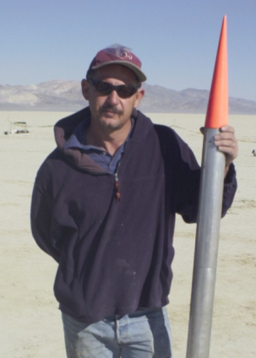
Meet the S4 partners
Association of Experimental Rocketry of the Pacific (AeroPac) – the Northern CA/Nevada chapter of the Tripoli Rocketry Association
Tony Alcocer – President
Ken Biba – Education Director
Endeavour Institute – Balloon Fests
Steve Kliewer, Director
We also partner with a few other rocket clubs: LUNAR (Livermore Unit of NAR) and ROC (Rocketry Organization of California) for launches

Slide 5
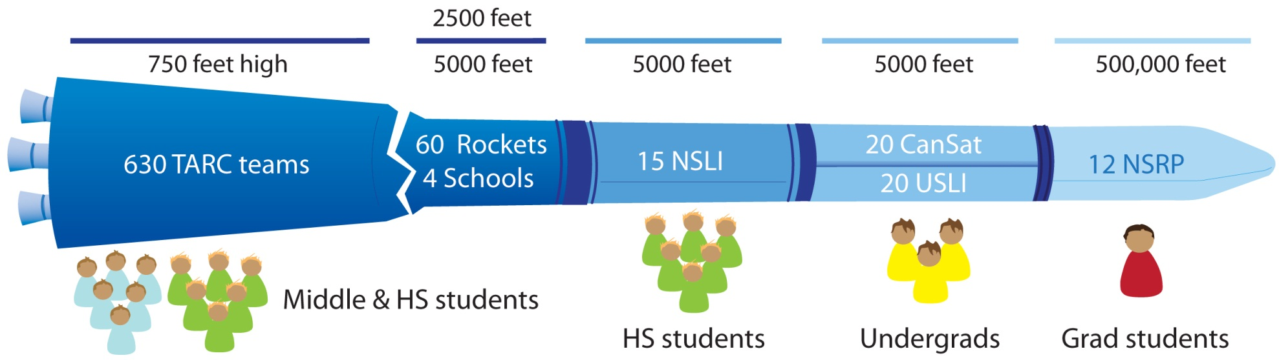
STEM Pipeline for rocketry

Slide 6
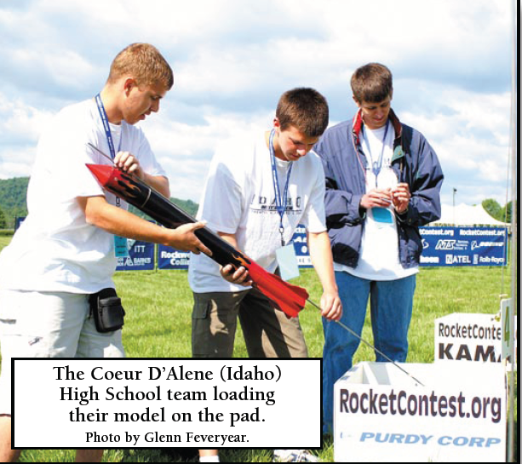
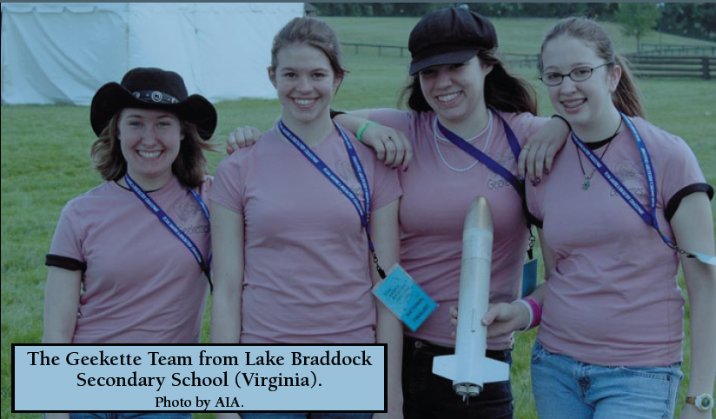
Team America Rocketry Challenge
About 7000 students nationwide
Model rockets that usually loft eggs to 500-750 feet and return them unbroken

Slide 7
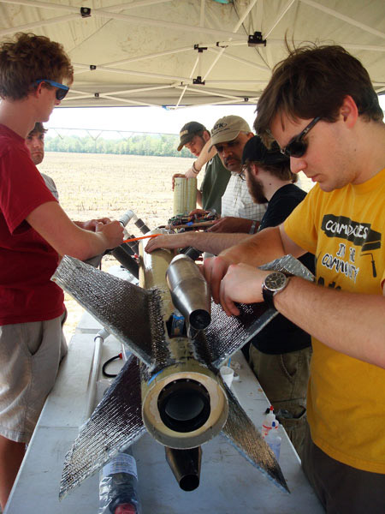
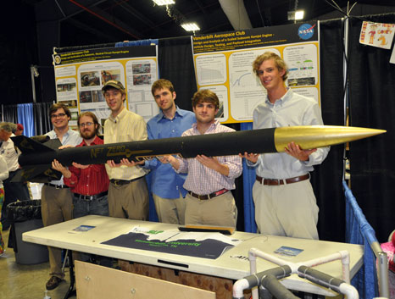
NASA Student Launch Initiative
~25 teams (middle/HS) chosen from TARC finalists
Rigorous review process (PDR, CDR, FRR)
Build payloads and HPRs, launch in Alabama to 5000 feet
Also University level competition with another ~25 teams

Slide 8
Model vs. High Power Rocketry
Motors are rated by thrust in Newton-seconds
Each letter is a factor of 2 more thrust
Model rockets are ¼ A to G (160 N-s, max)
HP rocketry is H and above
Level 1 is H and I (640 N-s max)
Level 2 is J and K (2560 N-s max)
I am a Level 2 flyer (so are Kevins J. and Z.)

Slide 9
Motor Classifications
A | 1.26-2.5 N·s
B | 2.51-5.0 N·s
C | 5.01-10.0 N·s
D | 10.01-20.0 N·s
E | 20.01-40.0 N·s
F | 40.01-80.0 N·s
G | 80.01-160.0 N·s
H | 160.01-320 N·s
I | 320.01-640 N·s
J | 640.01-1,280 N·s
K | 1,280.01-2,560 N·s
L | 2,560.01-5,120 N·s
M | 5,120.01-10,240 N·s
N | 10,240.01-20,480 N·s
O | 20,480.01-40,960 N·s
Total impulse
Low Power
J-350
High Power
L1
Average thrust
L2
L3
Space Shuttle SRB
5Z | 671,088,640.01-1,342,177,280 N·s

Slide 10
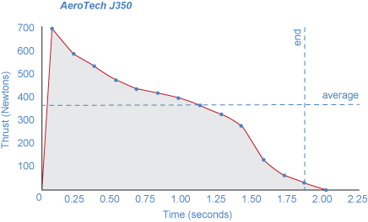
Thrust Curve

Slide 11
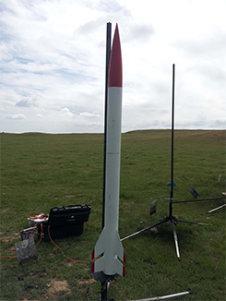
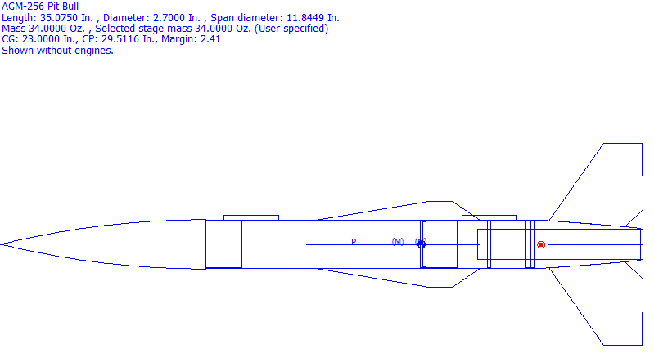
Airframe Design
Manufactured Kit
Scratch Built
Materials
Fiberglass
Cardboard
Carbon Fiber
Aluminum

Slide 12
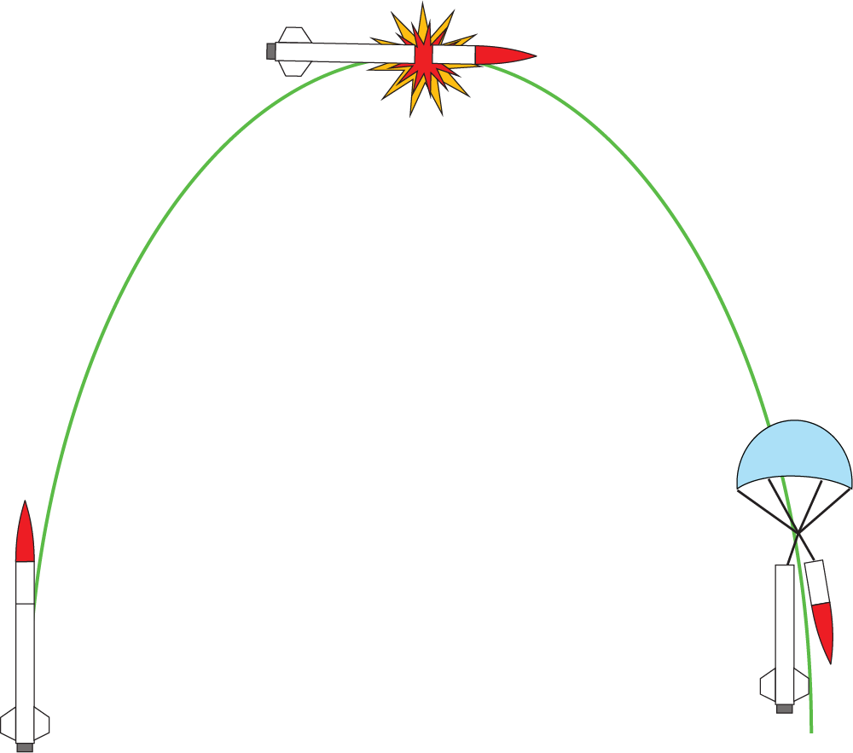
Ballistic Profile
Very Important
Time delay
Electronics/Avionics
Chute deployment
Apogee/
Separation
Launch
Recovery

Slide 13
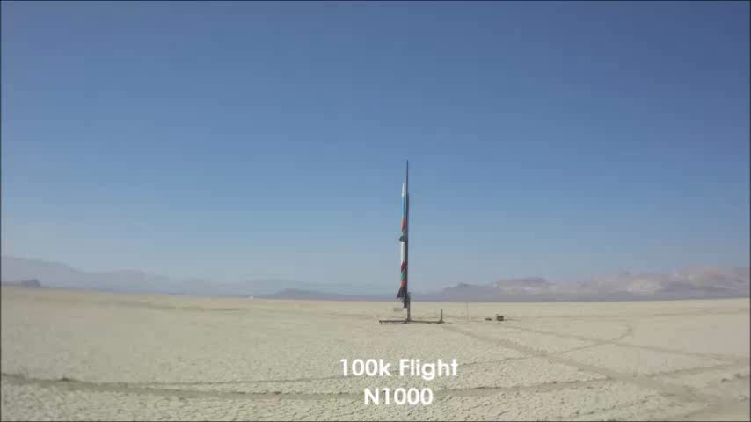
High Powered Rocketry

Slide 14
ARLISS as the inspiration for S4
AeroPac and Bob Twiggs started A Rocket Launch for International Student Satellites (ARLISS) over 10 years ago
University students from across the globe come to the Black Rock playa to launch payloads which are ejected from the rockets
Mostly students from Japan, but also Korea, India, Turkey, and a few from the USA

Slide 15
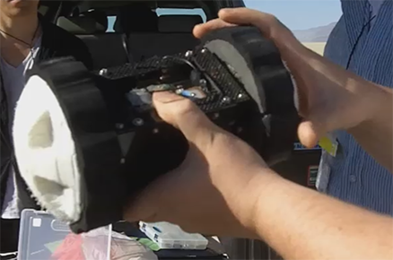
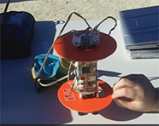
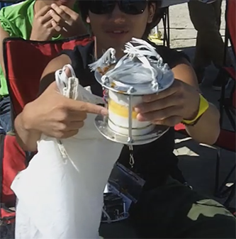
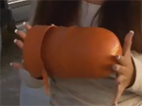
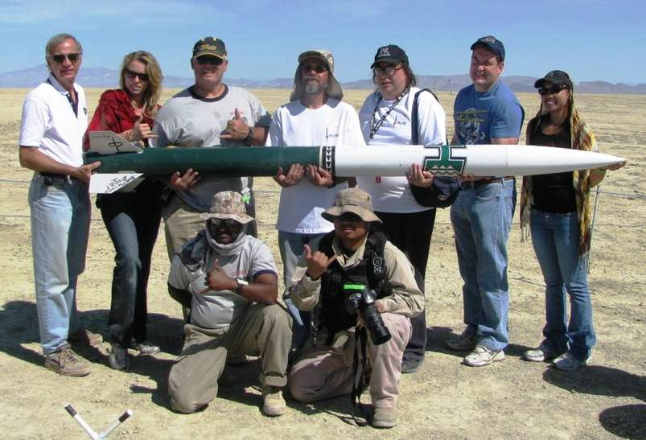
ARLISS
A Rocket Launch for International Student Satellites
Collaboration between engineering students and amateur rocket flyers
Various payload designs flown over the years include come-back rovers and scientific instruments
Black Rock Desert simulates harsh alien environments

Slide 16
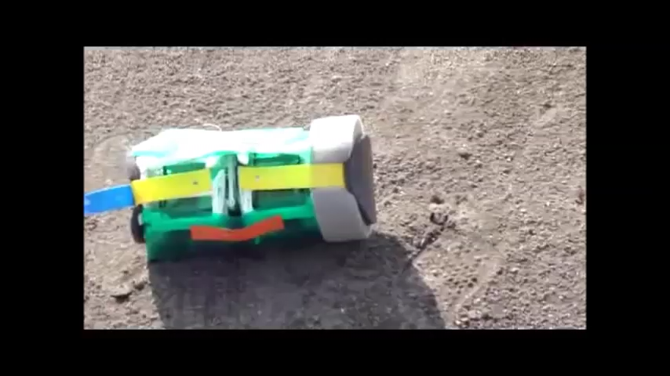
ARLISS

Slide 17
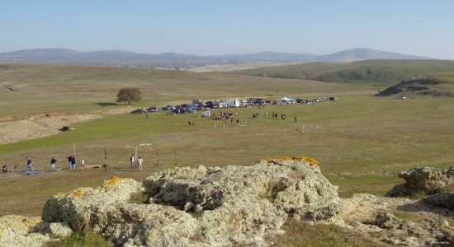
Launch Sites
LUNAR: Snow Ranch (15,000 ft limit, M motor max)

Slide 18
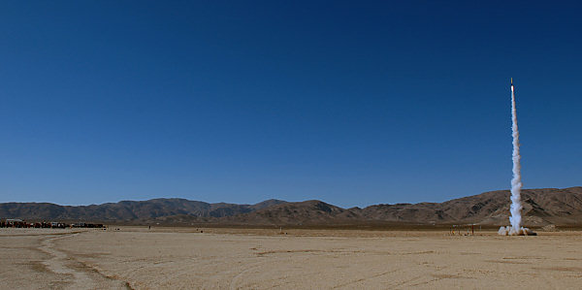
Launch Sites
ROC: Lucerne Lake Bed (10,000 ft limit, M motor max)

Slide 19
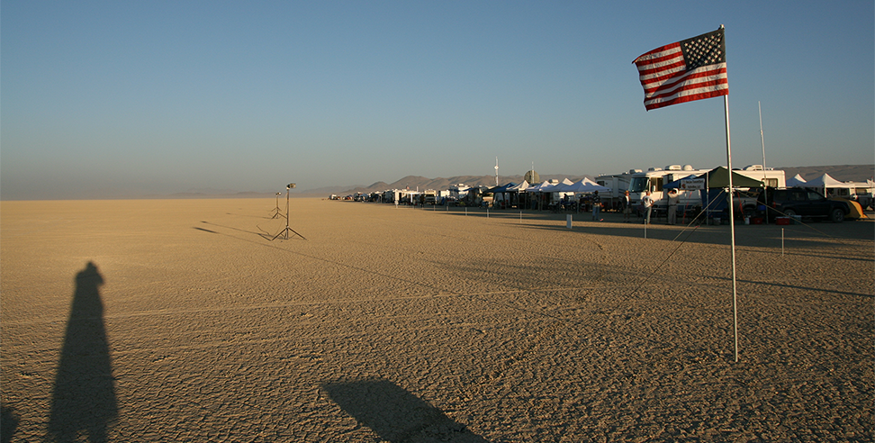
Launch Sites
AeroPAC: Black Rock Playa (200,000 ft limit)

Slide 20


High Powered Rocketry and YOU
Certification Process:
Level 1 – Build, fly and recover an airframe on an L1 motor
Level 2 – Build, fly and recover an airframe on an L2 motor and pass a written test
Level 3 - Build, fly and recover an airframe on an L3 motor using electronics
Upcoming Launches:
LUNAR: December 7, 2013: Snow Ranch (needs to rain before then. Or maybe December 14 or January 4, 2014.)
ROC: December 14, 2013 then January 11, 2014 - Lucerne
AeroPAC: June 20-22, 2014 Mudrock – Black Rock
LUNAR http://lunar.org/
AeroPac http://aeropac.org/
ROC http://rocstock.org/

Slide 21
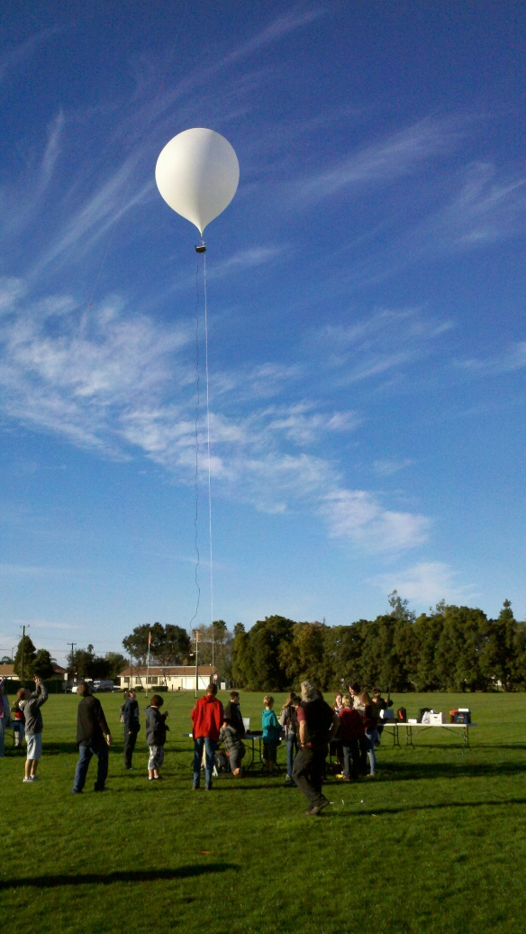
Tethered Balloons
Doesn’t require certification or complicated FAA clearance
Less expensive
Doesn’t require advanced equipment for telemetry
Less constraints on payload size and weight
Can be flown tethered to 1,000 feet or untethered
Greater control over altitude
Much longer time series for data

Slide 22
Balloonfest
Regional Balloonfest – December 7, 2013
Allan Hancock College, Santa Maria, CA
Championship Balloonfest – May 3, 2014
Tobin James Winery, Paso Robles, CA
Details:
Teams of 3-6 students
Level 1 experiments for elementary and middle school students
Level 2 experiments for HS students
Some room for advanced experimenters
Prizes for best presentations!
Sponsored by the Endeavour Institute

Slide 23
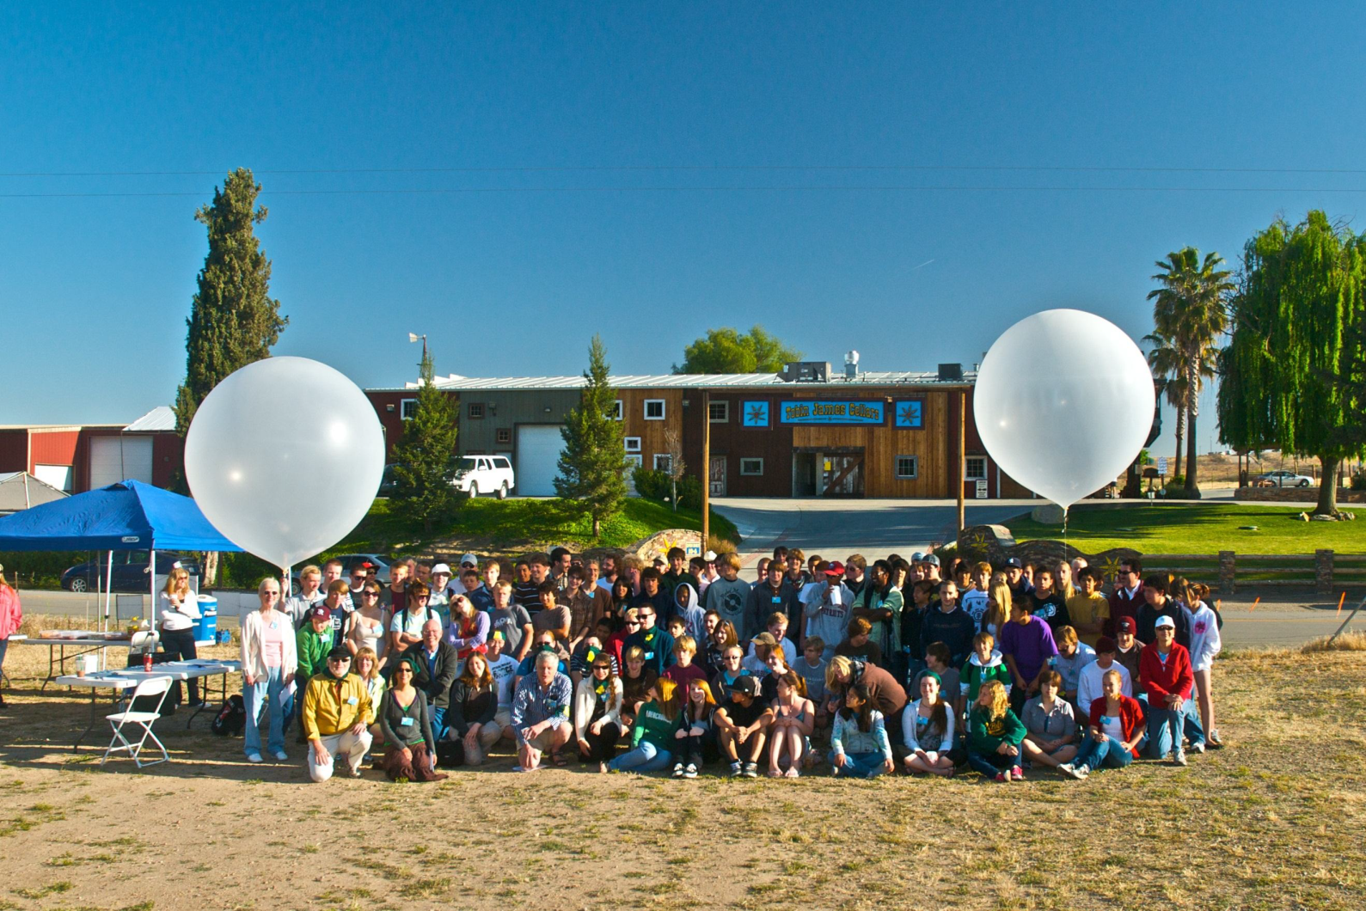
Balloonfest
Tobin James Cellars, Paso Robles, Ca

Slide 24
The S4 Project
For the past 3 years, the SSU team has been learning how to fly rockets and balloons, while designing the S4 flight electronics and software
We have designed a “flight board” which includes base components and optional sensors and have written an educator guide with background information, instructions and additional resources.
Last summer, we trained a group of teachers to build these payloads and launched them at Lucerne in Southern California with ROC

Slide 25
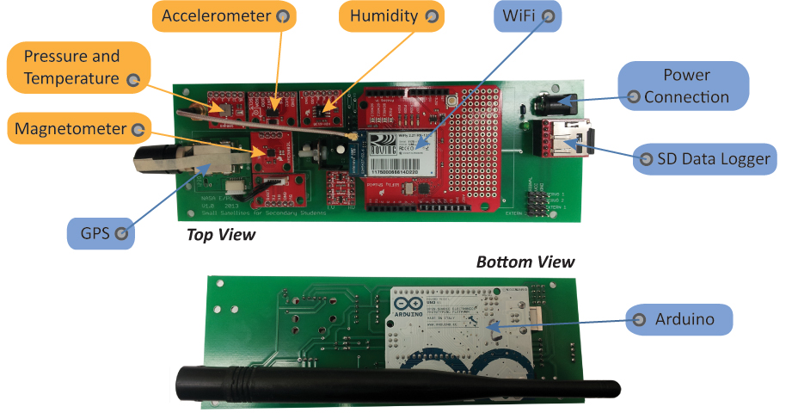
S4 Payload

Slide 26
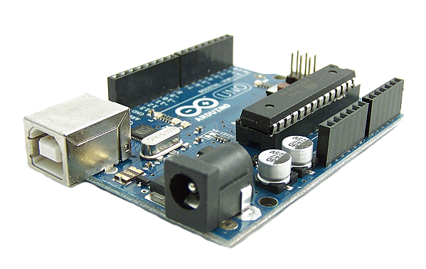
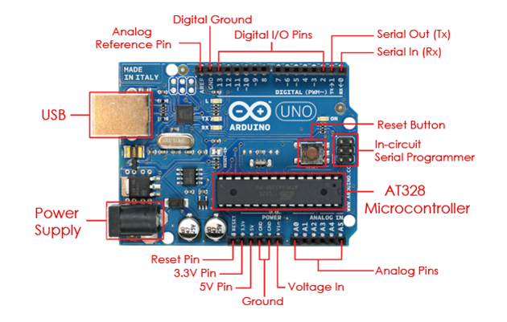
Arduino
Open-source physical computing platform based on a simple microcontroller board, and a development environment for writing software for the board.
Inexpensive (~$30 board)
Platform agnostic
Easy to program (C/C++)
Open source software – Software where the source code is made freely available
Open source hardware – Hardware where the design specifications are made freely available
Low Power

Slide 27
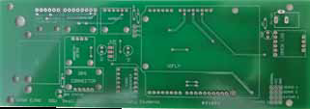
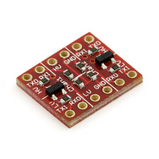
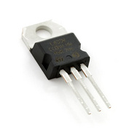
Flight Board
Major Subcomponents
Logic Level Converter – Steps 5V source from Arduino down to 3.3V source for payload components
Printed Circuit Board (PCB)
NOT off the shelf (yet) - provided by us
Physical backbone of the payload
Facilitates power and communication between payload components
Requires soldering skill to assemble
Does not require soldering skill to attach components once assembled
Manufacturing partner for assembly?
Voltage Regulator – protects payload components from over-voltage. Dissipates extra energy as heat.

Slide 28
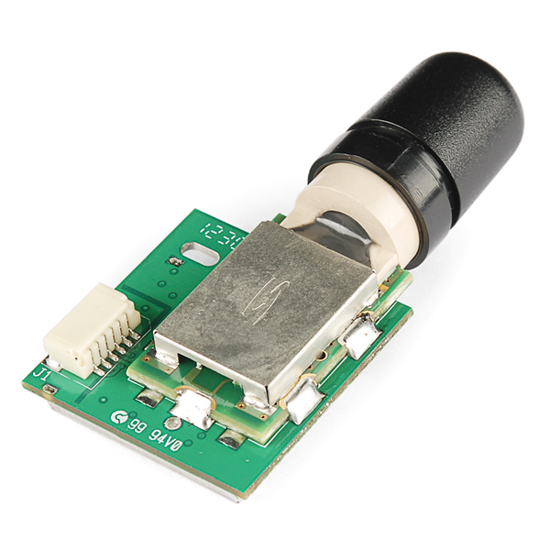
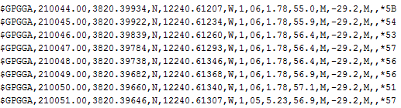
GPS
Determine Latitude, Longitude, Altitude and Time for payload data points
Same type of GPS as cell phones and Navigation
Requires satellite signal to lock
Lock can take up to two minutes

Slide 29
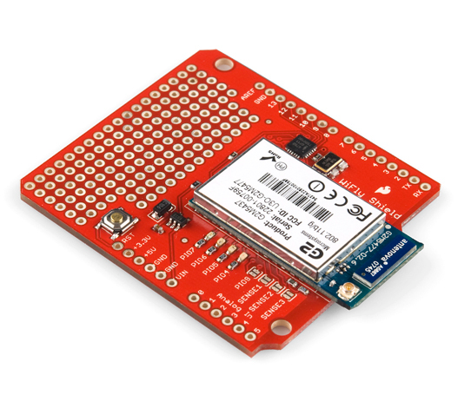
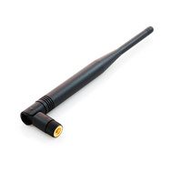
WiFly
Same type of Wi-Fi as computers and cell phones (802.11 b/g)
Example of an Arduino Shield (shares pins with Arduino)
Prototyping holes (unused)
Maintain real-time telemetry throughout the flight
Must be configured with network information
Duck antenna improves signal
Orientation not particularly important
Not needed for classroom testing

Slide 30
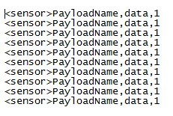
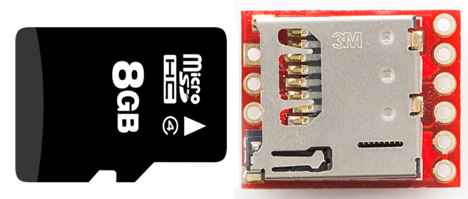
Open Log (SD)
Collect and store data without need for wireless networking
Maintain data collection if and when wireless signal lost
Same type of micro SD as cell phones
Writes to a plain text file
SD card reader and micro to standard adapter needed to recover data

Slide 31
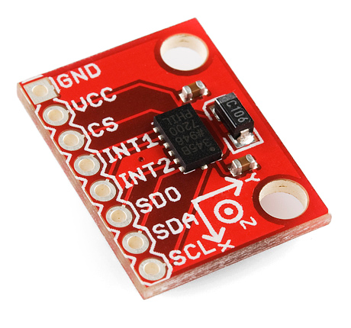
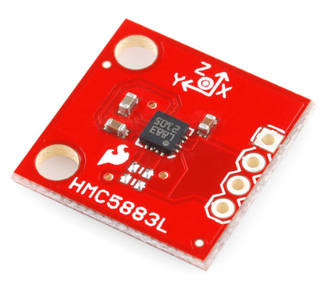
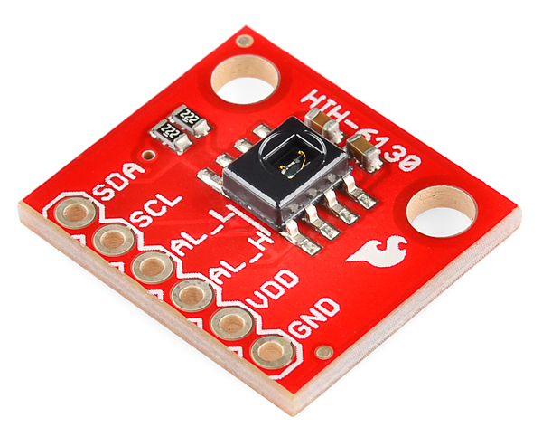
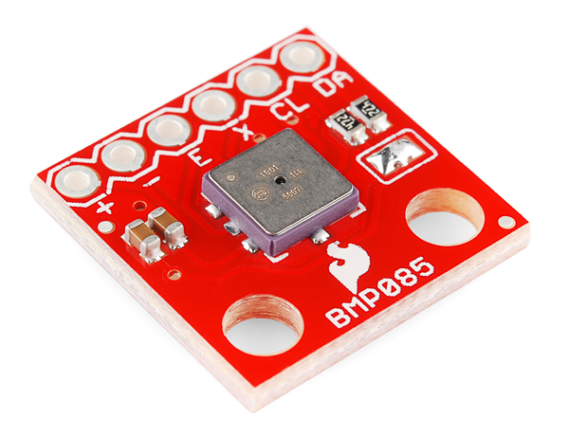
Sensors
Accelerometer
Magnetometer
Humidity and Temperature
Barometric Pressure
And Temperature

Slide 32
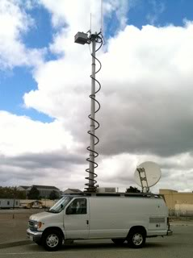

The Virtual Classroom
Wi-Fi antennas and routers for supporting live telemetry from payloads
Facilitate communication between payloads and local observers
Satellite Internet for sending live telemetry and video to remote observers
Administered by AeroPac and partially funded by our project
Designed and built by AeroPac Education Director Ken Biba

Slide 33

S4 Teacher Training – July 2013
Aero Institute, Palmdale Ca
18 educators from a diverse set of schools and other teaching organizations
Week long course
Built, tested and flew a prototype payload
Helped us refine our educational materials and the payload itself
Included talks from our partners and mentors

Slide 34

The first two days were spent learning the basics of electronics and soldering which were then put to use in constructing the flight board.

Slide 35

Beth Hill, Lawrence Jones Middle School
Once the flight board was finished the educators were introduced to programming in Arduino’s Processing language. They were then able to upload the programs to the payload after which they installed the sensors onto the flight board and finalized the payload.

Slide 36


On Thursday the educators took their payloads out to a local high school’s fields. They readied their payloads for tethered helium balloon flights, three-to-a-gondola, as dark storm clouds were approaching.
Once a helium balloon was filled and tethered the winds really kicked up and it began to rain.
With the weather too chaotic to fly helium balloons, the educators took their payloads around the high school on foot in order to get data.

Slide 37


On Saturday the training was shifted to the Lucerne dry lake bed about 70 miles east of Palmdale. There, the payloads were flown on 3 and 4 inch diameter rockets to altitudes as high as 1828.1m (6000 feet) with on-site routers taking live data of each launch.
The bottom figure shows our three highest flight paths, as determined by the GPS chips on board.
Donald Repucci, Morrow Bay

Slide 38

Everything thing went perfectly…
Nose cone from “lawn dart” rocket
…right up until the last flight

Slide 39
What’s Next?
Over the next year, students of the teachers from our training will be building and flying payloads of their own (around 55 teams total)
Working with suppliers and manufacturers to try and make the parts needed to build the S4 payload more readily and easily available
Address some supply chain concerns
Publish revisions to our educational materials
Try to continue program through NASA similar to NSLI but on the West Coast

Slide 40

For more information about this project visit:
s4.sonoma.edu
To learn more about our other projects:
epo.sonoma.edu

