Slide 1
Prof. Lynn Cominsky Sonoma State University
Next Generation Science Standards
and

Slide 2

Next Generation Science Standards
Developed in multi-year process by NRC
Adopted by 26+ states
Teaching and learning science the way it is really done – not just a collection of facts to memorize
1

Slide 3
Three Dimensions
Scientific and engineering practices
Describe behaviors that scientists engage in as they investigate and build models and theories about the natural world.
Key set of engineering practices that engineers use as they design and build models and systems.
Crosscutting concepts
Have application across all domains of science.
Link the different domains of science.
Disciplinary core ideas
Focus K–12 science curriculum, instruction and assessments on the most important aspects of science.
2

Slide 4
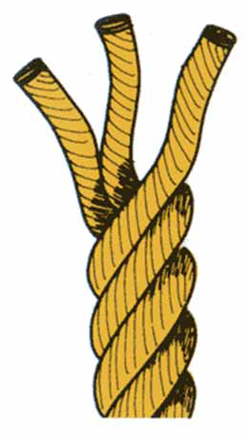
How to View
The three dimensions need to be considered as an integrated system.
• Practices are the processes of building and using the core ideas to make sense of the natural and designed world
3

Slide 5
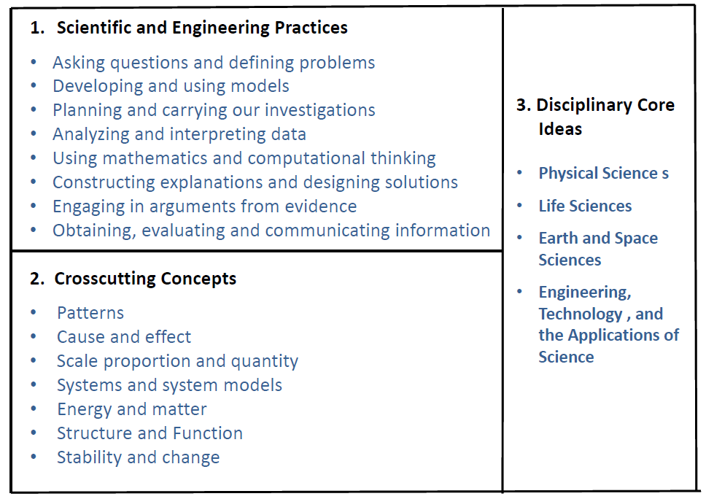
Defining the Dimensions
4

Slide 6
What are scientific practices?
Behaviors that scientists engage in as they investigate and build models and theories about the natural world.
Used instead of a term like “skills” to emphasize that engaging in scientific inquiry requires coordination of both knowledge and skills simultaneously.
Use of the term practices helps avoid the interpretation of skill as rote mastery of an activity or procedure.
Part of the NRC’s intent is to better explain and extend what is meant by “inquiry” in science and the range of cognitive, social, and physical practices that it requires.
5

Slide 7
What are Crosscutting Concepts?
Crosscutting concepts have application across all domains of science.
They help link the different domains of science.
Patterns, similarity, and diversity;
Cause and effect;
Scale, proportion and quantity;
Systems and system models;
Energy and matter;
Structure and function;
Stability and change.
6

Slide 8
What are disciplinary core ideas?
Focus K–12 science curriculum, instruction and assessments on the most important aspects of science. Should have at least two of the following:
Have broad importance across multiple sciences or engineering disciplines or be a key organizing concept of a single discipline;
Provide a key tool for understanding or investigating more complex ideas and solving problems;
Relate to the interests and life experiences of students or be connected to societal or personal concerns that require scientific or technological knowledge;
Be teachable and learnable over multiple grades at increasing levels of depth and sophistication.
Disciplinary ideas are grouped in four domains: the physical sciences; the life sciences; the earth and space sciences; and engineering, technology and applications of science.
7

Slide 9
Conceptual Shifts in the NGSS
K–12 science education should reflect the real world interconnections in science
Using all practices and crosscutting concepts to teach all core ideas all year
Science concepts build coherently across K-12
The NGSS Focus on deeper understanding and application of content
Integration of science and engineering
Coordination with Common Core State Standards
8

Slide 10
Standards Comparison: Structure and Properties of Matter
Current State Middle School Science Standard
NGSS Middle School Sample
Distinguish between atoms and molecules.
Describe the difference between pure substances (elements and compounds) and mixtures.
Describe the movement of particles in solids, liquids, gases, and plasmas states.
Distinguish between physical and chemical properties of matter as physical (i.e., density, melting point, boiling point) or chemical (i.e., reactivity, combustibility).
Distinguish between changes in matter as physical (i.e., physical change) or chemical (development of a gas, formation of precipitate, and change in color).
Recognize that there are more than 100 elements and some have similar properties as shown on the Periodic Table of Elements.
Identify and demonstrate the Law of Conservation of Matter.
Construct and use models to explain that atoms combine to form new substances of varying complexity in terms of the number of atoms and repeating subunits.
Plan investigations to generate evidence supporting the claim that one pure substance can be distinguished from another based on characteristic properties.
Use a simulation or mechanical model to determine the effect on the temperature and motion of atoms and molecules of different substances when thermal energy is added to or removed from the substance.
Construct an argument that explains the effect of adding or removing thermal energy to a pure substance in different phases and during a phase change in terms of atomic and molecular motion.
9

Slide 11

Why not inquiry ?
Engineering design is similar to scientific inquiry, but there are significant differences.
Scientific inquiry involves the formulation of a question that can be answered through investigation, while engineering design involves the formulation of a problem that can be solved through design.
10

Slide 12
CC Literacy in Science vs. NGSS
The CCSS Literacy Standards were written to help students meet the particular challenges of reading, writing, speaking, listening, and language in their respective fields-in this case, science.
The literacy standards do not replace science standards-they supplement them.
The NGSS will lay out the core ideas and practices in science that students should master in preparation for college and careers.
11

Slide 13
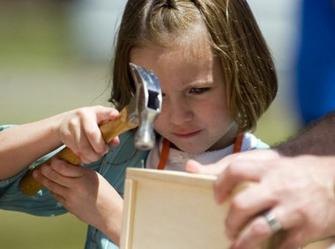
What is Learning by Making?
One of only 18 Investing in Innovation (i3) development projects awarded in 2013 by the U.S. Department of Education
Five-year program to develop engaging, hands on, project-based learning that integrates science and mathematics
2 new high school STEM courses:
Environmental Science/Biology
Chemistry/Physics
12

Slide 14
Learning by Making team
PI Susan Wandling (SSU Early Academic Outreach)
STEM Lead Lynn Cominsky (SSU Education and Public Outreach)
Mendocino County Office of Education
Six partner rural high-needs high schools:
Anderson Valley Fort Bragg
Point Arena Round Valley
Ukiah Willits
13

Slide 15

Innovations
Use of computational thinking to focus on real world problem solving
Solutions are constructed by teachers and students working together
Use of Logo programming language – overcomes barrier to learning how to code
Sensor based experiments that are networked
Simulations and modeling
14

Slide 16

Our goals
Develop two year-long integrated high school STEM courses that will be accepted as elective credit for university eligibility in California
Train at least half of the science and mathematics teachers in our partner schools to successfully deliver the curriculum
Improve math and science proficiency by 15% for students enrolled in the new courses.
15

Slide 17
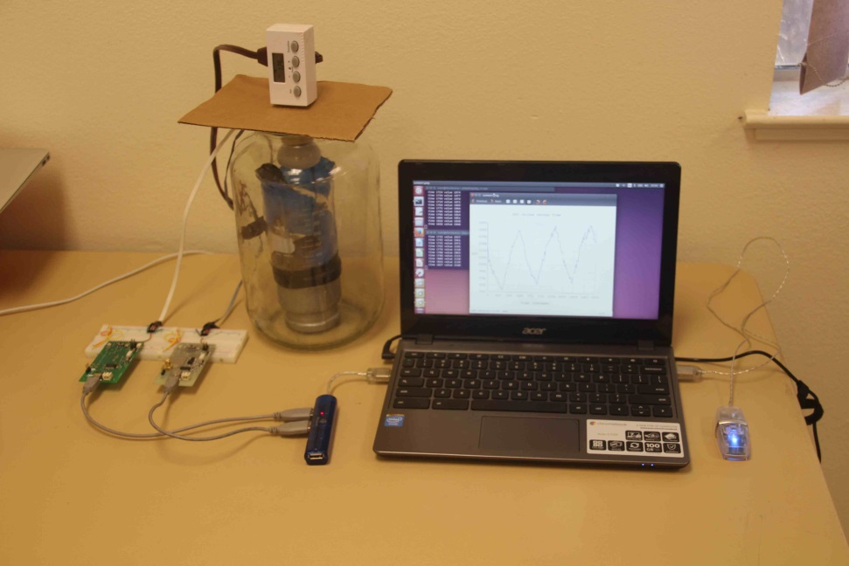
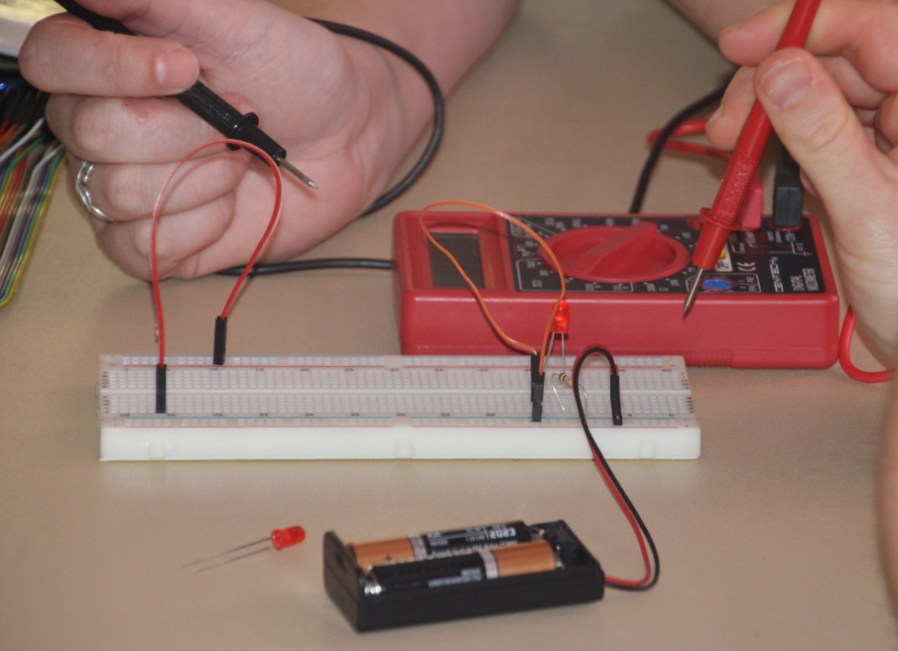
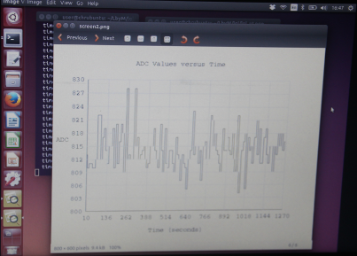
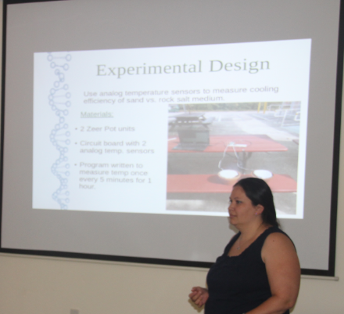
2014 Summer Institute

Slide 18
First year work plan overview
Write a Logo manual and build hardware platform
Initial design of Environmental Science and Biology experiments and sensor selection
Visit with teachers and principals to understand needs, infrastructure and how to successfully implement these ideas at the schools
10 days of professional development for teachers
Set up web-based infrastructure to allow real time debugging with teachers and students
Submit curriculum to UCOP for college-credit approval as Laboratory Science (Area D)
17

Slide 19
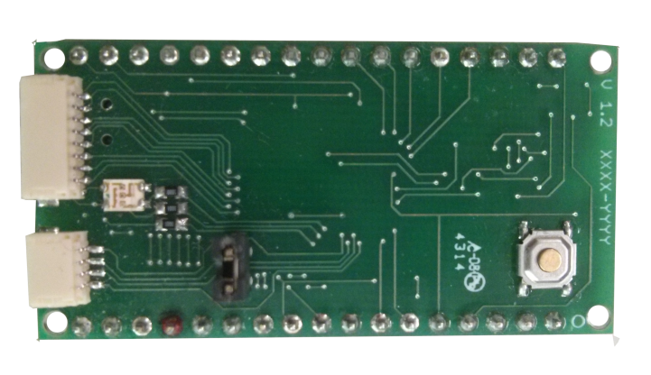
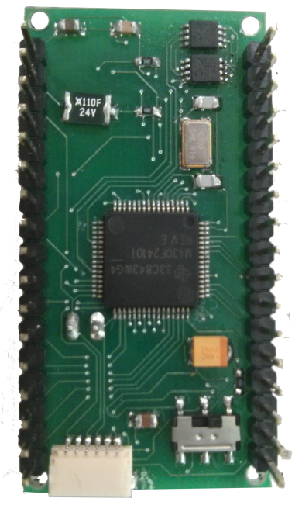
Hardware Interface Design
Modeled on SSU’s first Earth-orbiting satellite (T-LogoQube) – MSP 430 microprocessor
Uses packet-based data stream and radios for remote sensors “in the field”
Networks of sensors allow students to work together on experiments
Top view
Bottom view
18

Slide 20
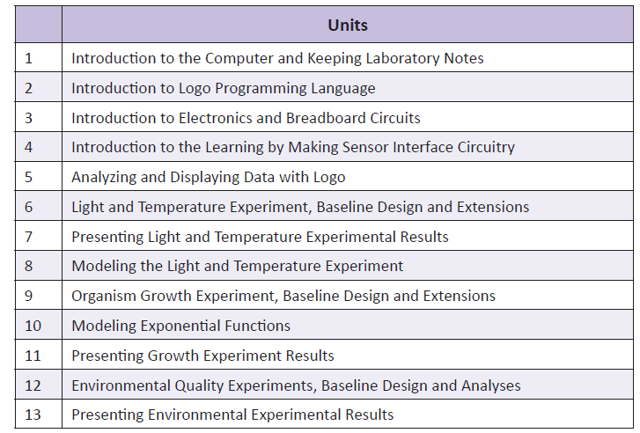
Curriculum overview – year 1
19

Slide 21
Light and temperature experiment
Four temperature sensors at different depths in sand
Light can be controlled to simulate day/night and adjusted to provide solar flux at surface
Simulation of diffusion model using Logo
Comparison to real borehole measurements to learn about Earth temperature history
20

Slide 22
Organism growth experiment
Microbes that create electricity by ingesting wastes – current increases as population grows
Useful for bioremediation of oil or winery wastes
Simulation of population growth and genetic propagation models using Logo
Comparison to real populations (e.g., foxes vs. rabbits) and GMOs
21

Slide 23
Environmental quality experiment
Measure radiation, air quality or water quality in local environment
Compare to global, national or regional data bases
http://blog.safecast.org - maps radiation levels and builds a sensor network, enabling people to contribute and freely use the data collected.
http://www.airnow.gov/- air quality maps of US, including particles and ozone
http://waterwatch.usgs.gov – continuous real-time water quality maps of surface water in US, including discharge, nitrates, pH and more
22

Slide 24
2015 Next Steps
Finish lesson plans for year 1 curriculum
Finish other two year 1 hardware experiments
Finish remote laboratory interface implementation
Sign students up for year 1 class
Purchase and distribute year 1 materials
Start Learning by Making!
23

Slide 25
For more information:
http://i3.sonoma.edu → Public Files
Thanks to Christine Royce and Stephen Pruitt for many of the NGSS slides
http://epo.sonoma.edu to learn about all of our projects
Cominsky Close to Home op-ed in 12/5/2014 Press Democrat http://www.pressdemocrat.com/opinion/3204004-181/close-to-home-new-standards
24

