Slide 1
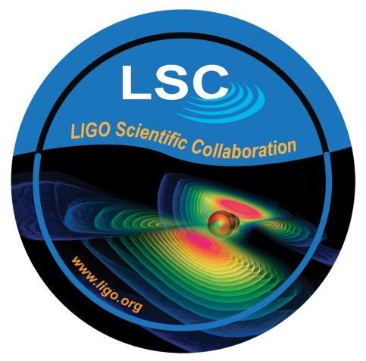
CPEP and Gravitation
Lynn Cominsky
Sonoma State University

Slide 2
Proposing a new CPEP section
Gravitation
Inspired by ongoing NSF-funded work on behalf of LIGO (Laser Interferometer Gravitational-wave Observatory)
First product would be a new poster highlighting LIGO and the (hopefully soon) discovery of gravitational waves
Just in time for Einstein’s centennial of General Relativity in 2016

Slide 3
What are gravitational waves?
Predicted by Einstein’s General Theory of Relativity
Compress and stretch spacetime
Travel at the speed of light
An entirely new way to view the Universe – once they are detected
Very hard to detect! (None seen to date, earliest possible detections in 2016)

Slide 4
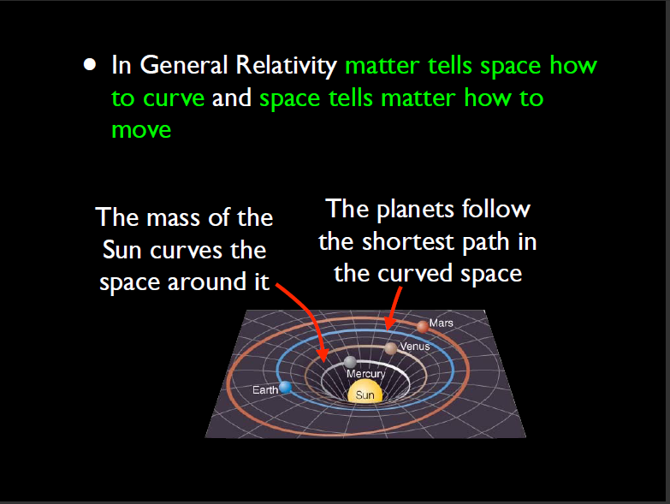

Slide 5
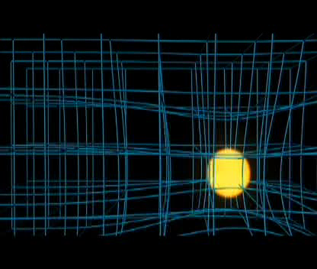
Spacetime curvature

Slide 6
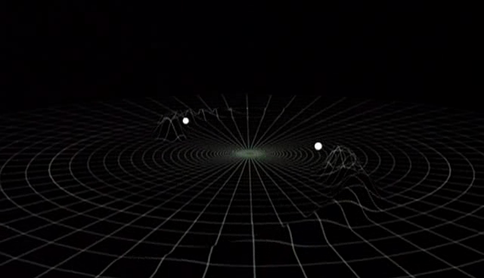
Binary in spacetime

Slide 7
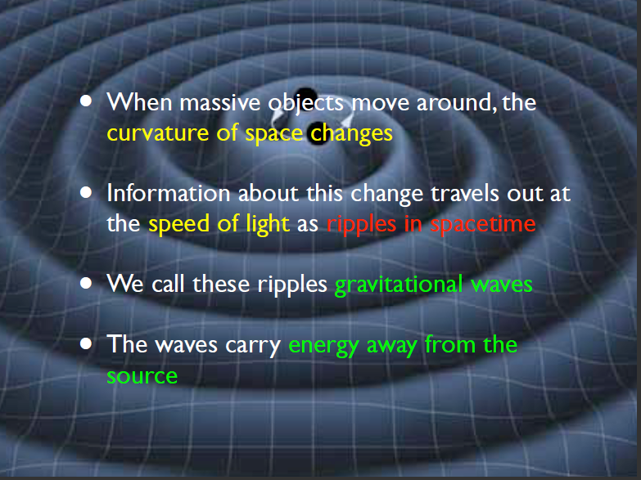

Slide 8
Gravitational Waves
Experiments to detect GWs are currently being upgraded
  LIGO (Hanford and Livingston) are now online and beginning engineering runs. By the end of 2015, they will begin the first science run. We hope to reach design sensitivity by 2017
  Virgo (Italy) expected to come online in 2016
  GEO (Germany) still operational (not as sensitive)
  LIGO (India) – pending agreement, perhaps in 2020+

Slide 9
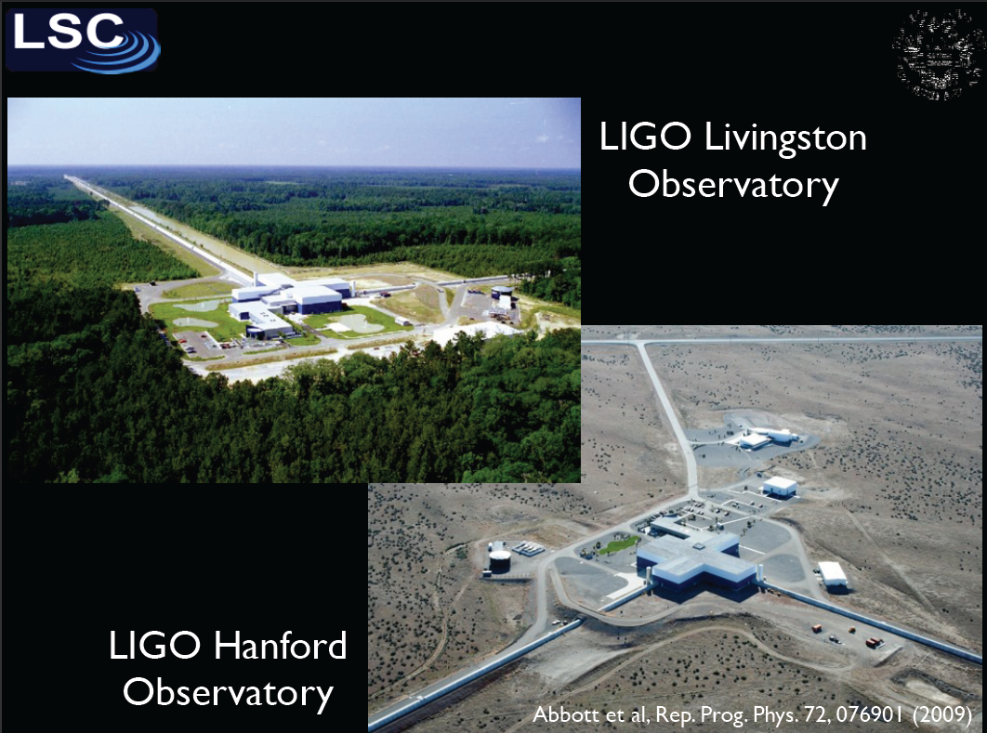

Slide 10
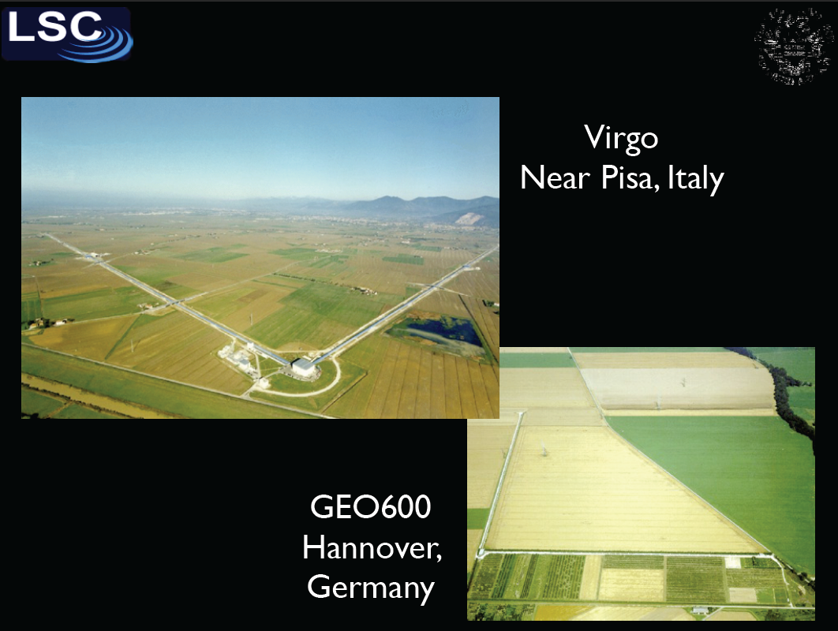

Slide 11
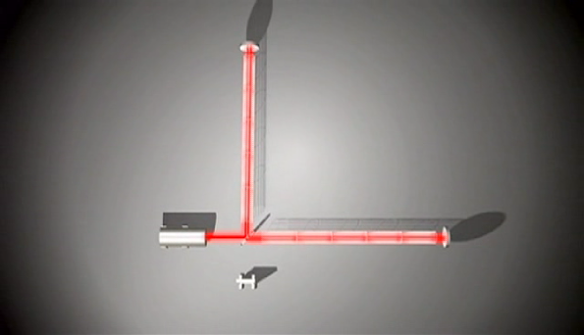
How LIGO works
Einstein’s messengers,
National Science Foundation video
http://www.einsteinsmessengers.org/

Slide 12
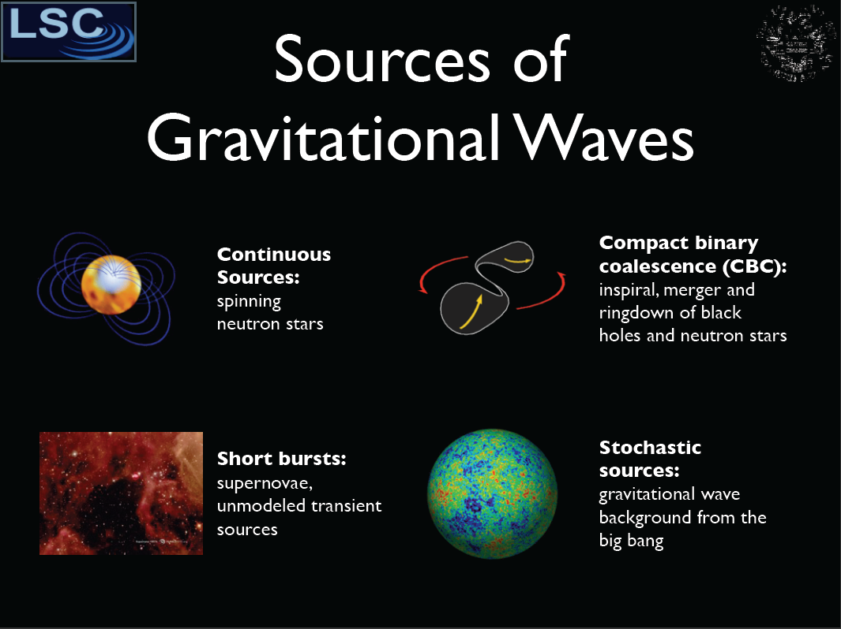
Gravitational Waves

Slide 13
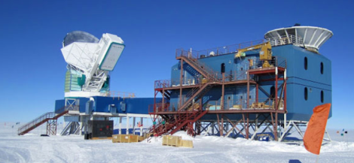
GW Spectrum

Slide 14
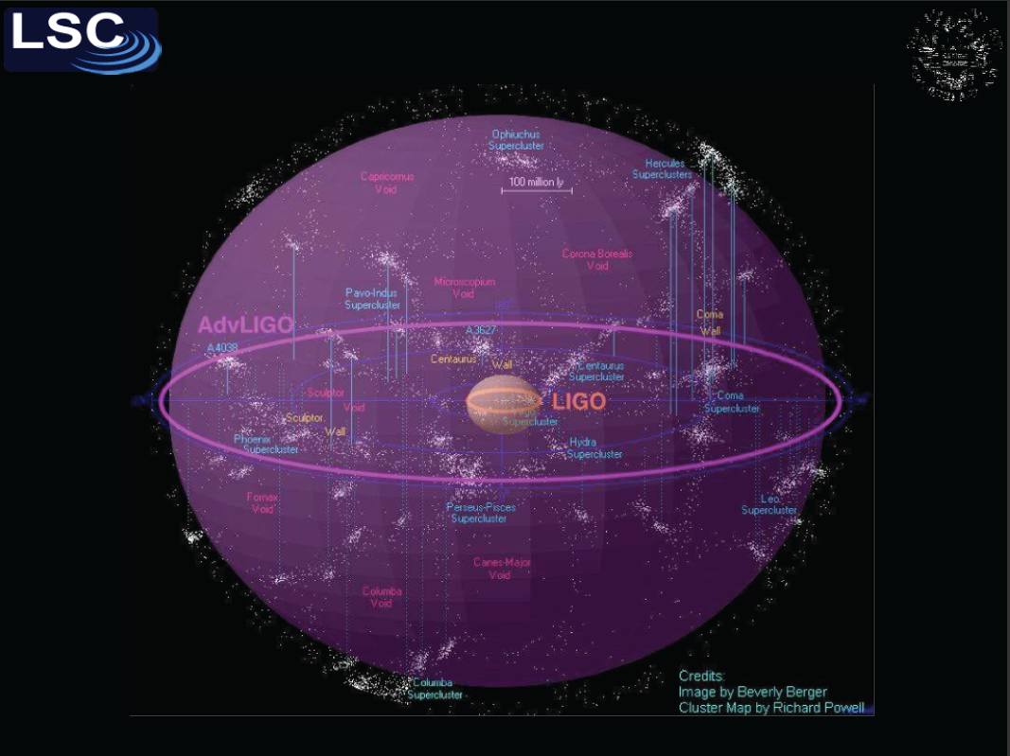

Slide 15
Resources for Physics teachers
GWs address much broader questions than just astronomy + lots of physics in the experimental design
At present, not many resources exist that are suitable for college or AP high school physics students
I have received NSF funding to develop these types of resources for training lower-division (especially Community College) teachers as well as web-based resources for students
The first new product would be a poster about waves and gravity that could be distributed (sold) by CPEP

Slide 16
Physics Resource website
Two new classroom units that describe LIGO science and LIGO technologies
  text, illustrations, conceptual and numerical exercises, multimedia resources such as animations and simulations, interactive computer applications, and homework problems
  links to useful existing materials for calculus-based physics classes in college or high school
  information about opportunities for LIGO-related student internships, REU programs and transfer opportunities to universities with LIGO-related research
  Linked to ligo.org – would also like to create a new CPEP section on gravitation

Slide 17
Educator Professional Development
Our first course – LIGO: Waves & Gravity is offered July 16 – Aug 6, 2015
Can sign up for academic or continuing education credit through Sonoma State University
Advertised through many channels but we could still use additional enrollment

Slide 18
Other things SSU can help with:
Online Cosmology curriculum for general education college students – being distributed by Kendall Hunt publishers
Big ideas in Cosmology – 18 chapters of online material
LIGO: Waves & Gravity will use four of these chapters: Light, Classical Gravity, Special Relativity and General Relativity

Slide 19
Big Ideas in Cosmology
Demo here

Slide 20
Next steps?
There are other LIGO Scientific Collaboration members (e.g., Jocelyn Reed from CSU Fullerton) who would also like to get involved with CPEP – how do I get them involved?
I am investigating what to do with our left over NASA posters and resources – possible to distribute (or sell?) through CPEP? I won’t know the answer to this for about a year, due to the transition in NASA STEM education

Slide 21
Backups Follow

Slide 22
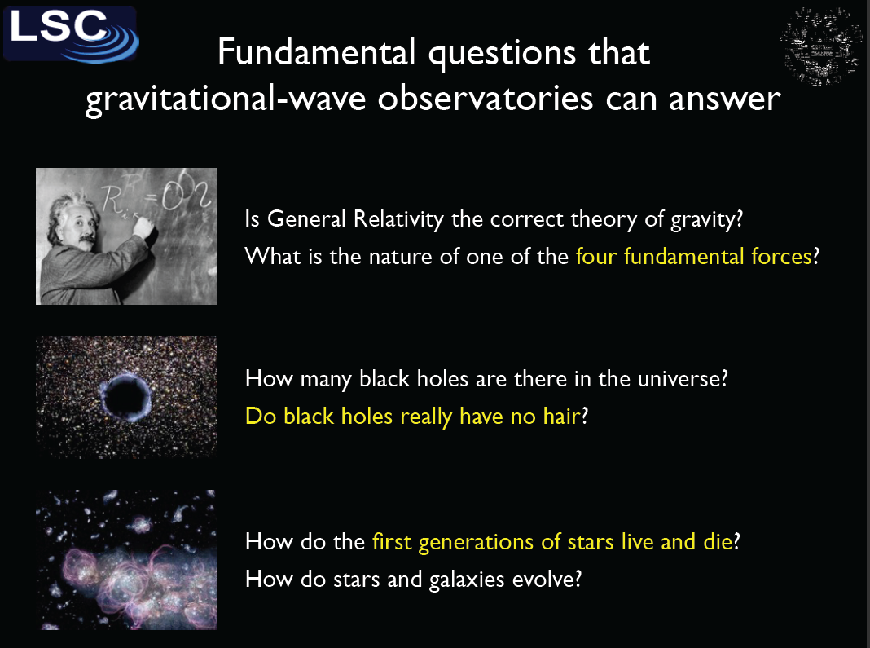

Slide 23
