Slide 1

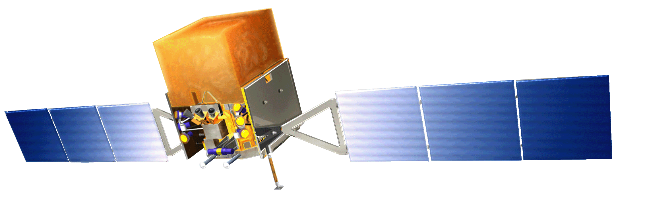
Big Ideas and Big Science in the Classroom
Prof. Lynn Cominsky
Sonoma State University

Slide 2
Outline
Global Telescope Network
http://gtn.sonoma.edu
Einstein@Home
http://einsteinathome.org
Big Ideas in Cosmology
http://www.greatriverlearning.com/Cosmology

Slide 3
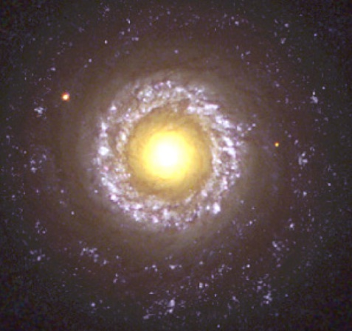
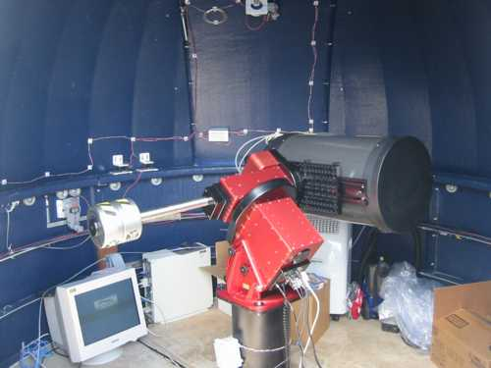
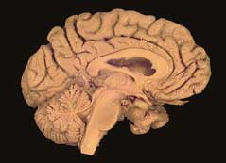
The Global Telescope Network
http://gtn.sonoma.edu

Slide 4
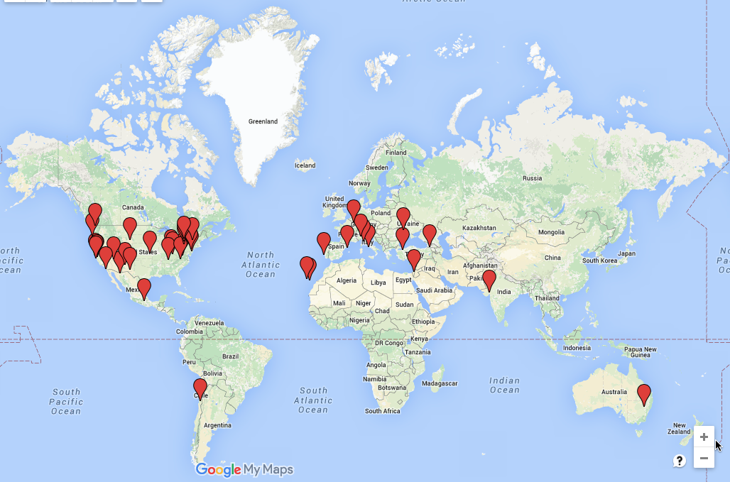
GTN partners
42 partners: especially UNC’s PROMPT network in Chile

Slide 5
Fermi Gamma-ray Space Telescope
Launched June 11, 2008
Studies gamma rays
over a very wide energy range
http://www.nasa.gov/fermi

Slide 6

GORT at Pepperwood
Students do ground-based visible-light observations using remote telescopes
GRBs and flaring blazars
Coordinated with Fermi and Swift satellite data

Slide 7
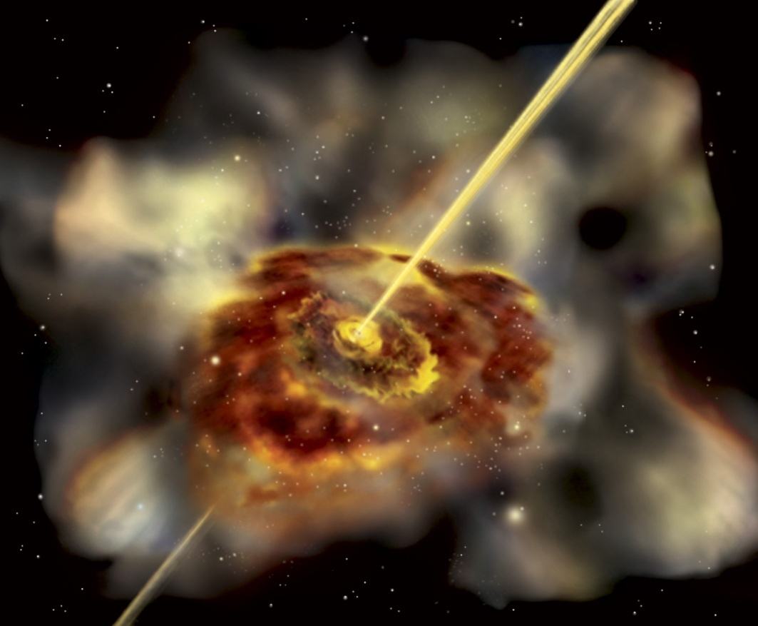
Gamma-ray Jets from Active Galaxies
Jets flare dramatically in gamma rays
Galaxies that point their jets at us are called “blazars”
How do the black holes send out jets?
Art by Aurore Simonnet

Slide 8
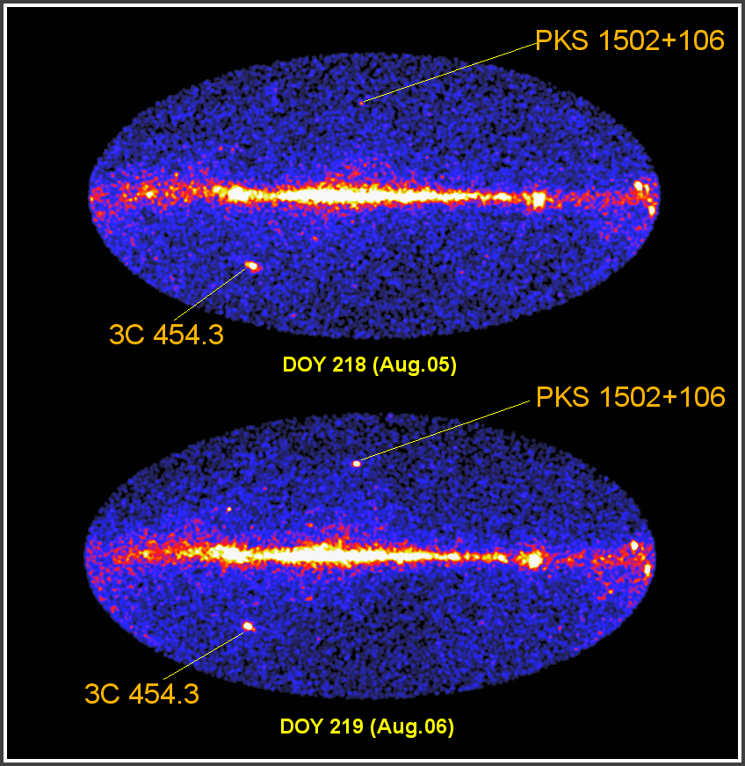
Monitoring Flares from “Blazars”
Fermi scans the entire sky every 3 hours
So blazar flares can be seen on relatively short time scales
Coordinated campaigns with many ground-based telescopes are providing information about how the flares are occurring

Slide 9
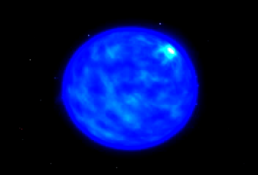
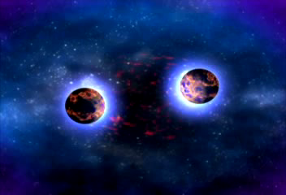
More super than a supernova?
A gamma-ray burst!
Long bursts (>2 seconds) may be from a hypernova: a super-supernova
Short bursts (<2 s) may be from merging neutron stars
GRBs are birth cries of black holes
Each GRB emits as much energy as our Sun in its entire lifetime!

Slide 10
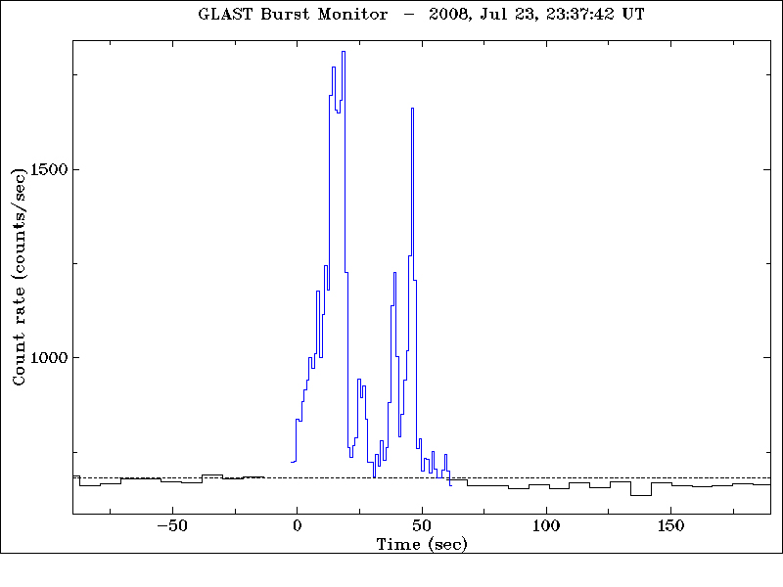
Typical strong GRB seen by Fermi
Once you’ve seen once gamma-ray burst….

Slide 11
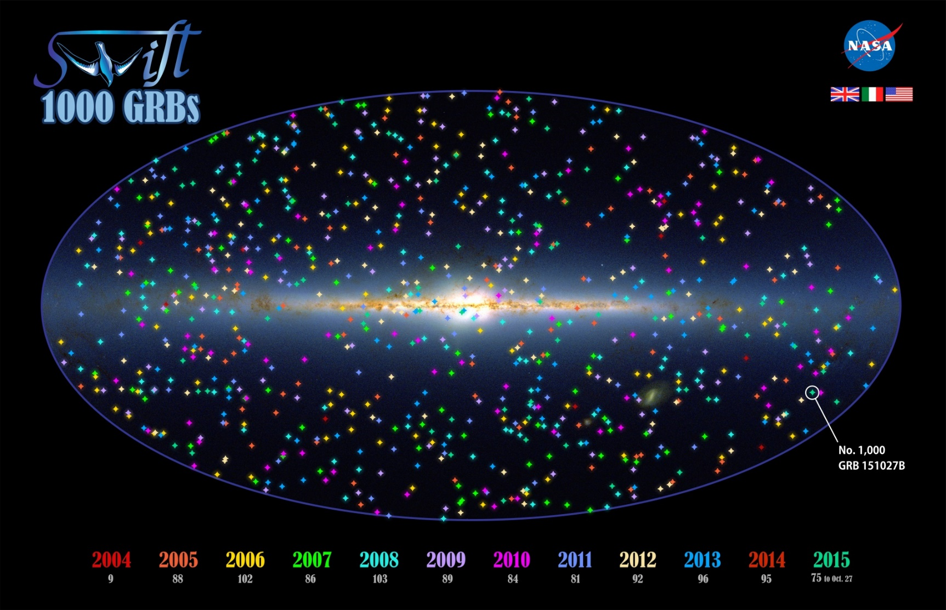
1000 GRBs seen with Swift

Slide 12
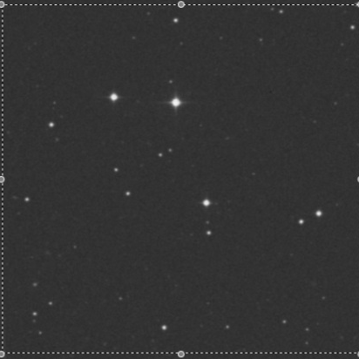
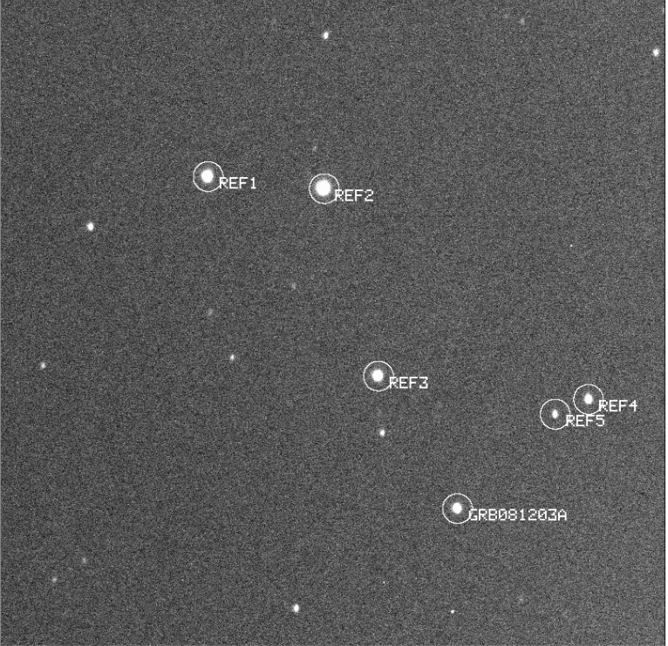
GRB afterglows with GORT
Before the GRB
After GRB081203A
We have detected 8 afterglows to date and 5 upper limits

Slide 13
Einstein@Home
Volunteer supercomputer
Citizen scientist screensaver project
Target: Spinning neutron stars
Originally designed to search for gravitational waves from LIGO
Has discovered ~54 radio pulsars in Parkes and Arecibo data
Five gamma-ray only pulsars from Fermi

Slide 14
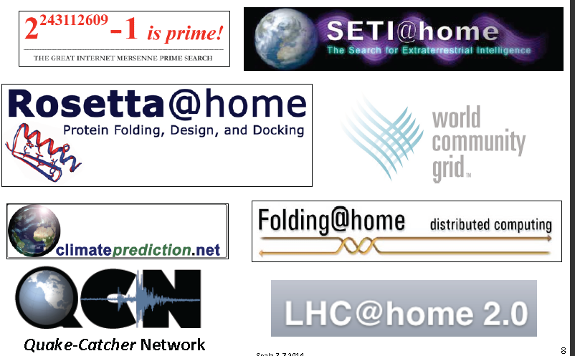
Other similar projects

Slide 15
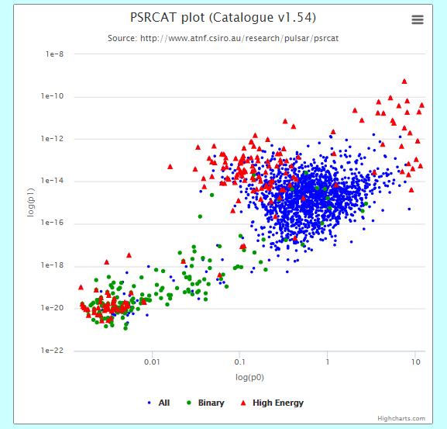
5 Fermi pulsars discovered
Young: 35 -56 kyr characteristic age
Rotation frequencies: 2 -10 Hz
All in the Galactic plane
All are radio-quiet (radio data are from ATNF pulsar catalog, Manchester et al. 2005)
Einstein at home GRP
Notes:
2 Hz Is slowest GRP ever found

Slide 16
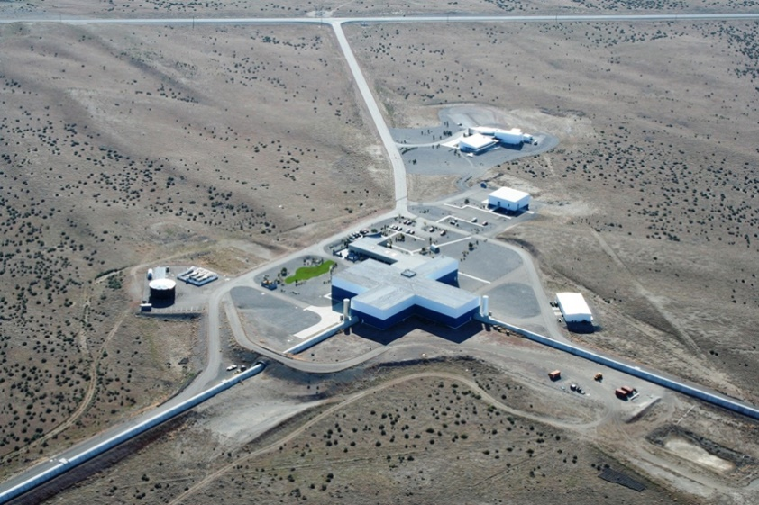
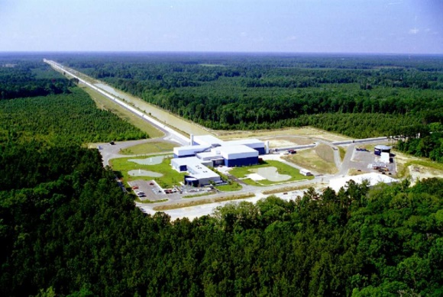
Gravitational Waves
Recent upgrades to the 2 LIGO observatories have increased the sensitivity by orders of magnitude
Hanford, Washington
Livingston, Louisiana

Slide 17
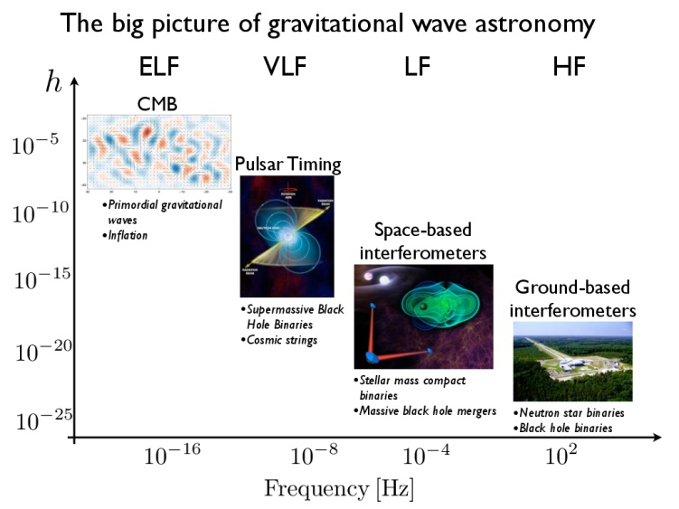
Expected sources of GWs

Slide 18

LIGO Open Science Center
https://losc.ligo.org
Currently offers access to data prior to “Advanced LIGO” – S5 and S6 data sets
Uses python and specialized viewing tools
Tutorials included! (S5 data)
Examples of student and citizen scientist projects: https://losc.ligo.org/projects/

Slide 19
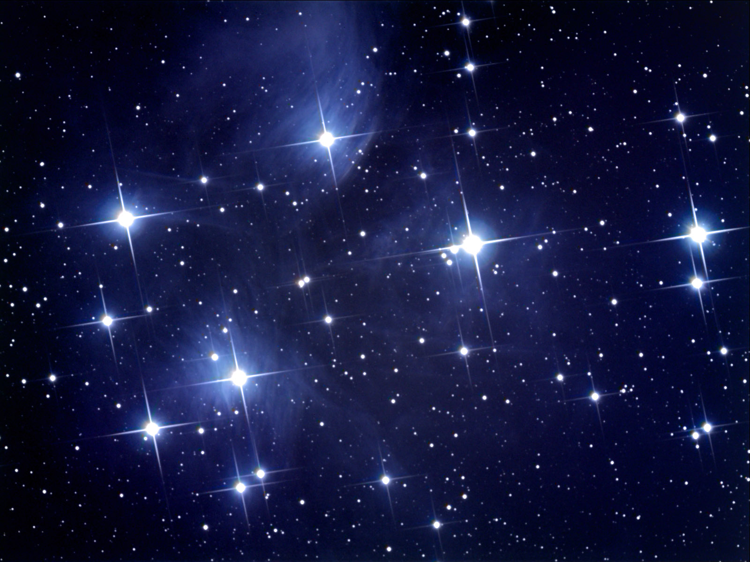
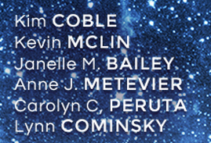

A Digital First Curriculum for College Students

Slide 20
What are the “Big Ideas in Cosmology”?
“We can use numbers to answer deep questions”
-Chicago SU student
Cosmology is the study of the universe as a whole: its origin, contents, structure, and evolution.
The cosmos is the backdrop against which we live and act.
And also…. a new web-based two-semester curriculum now available for adoption from Great River Learning

Slide 21
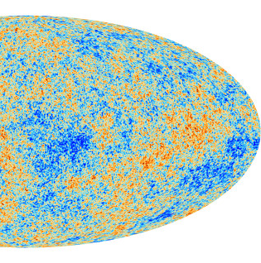
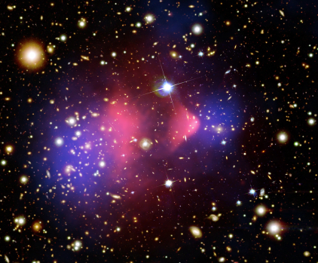
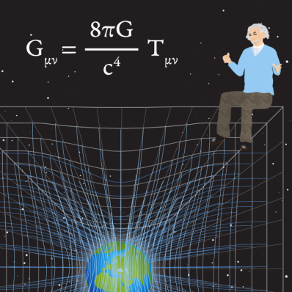
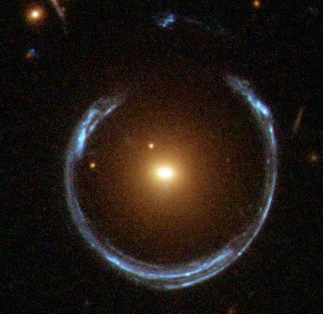
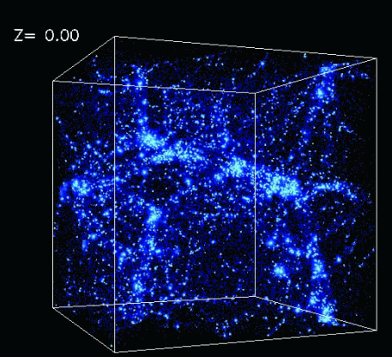
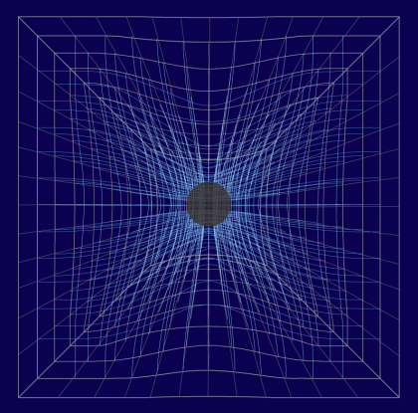
Why Cosmology (and not just Astronomy)?
Only about 20% of traditional Astro 101 textbooks are dedicated to cosmology
“If students come away with only process, and dull topics whose explanations were known hundreds or thousands of years ago, we are losing their place in science literacy and losing our chance to help them appreciate how wonderful it is to continue to work to understand the astronomical Universe”
– Jay Pasachoff
Early Universe
Dark Matter
Relativity
Gravitational Lensing
Structure Growth
Black Holes

Slide 22
Why Online?
Interactive and engaging
Scalable
Flexible and easy to update as scientific thinking evolves
Use online, hybrid or traditional pedagogies
Key features
Informed by peer-reviewed education research into preconceptions
Interactive format which uses real data
Engages students in higher levels of understanding, analysis and synthesis
Has been tested in flipped and online learning environments

Slide 23
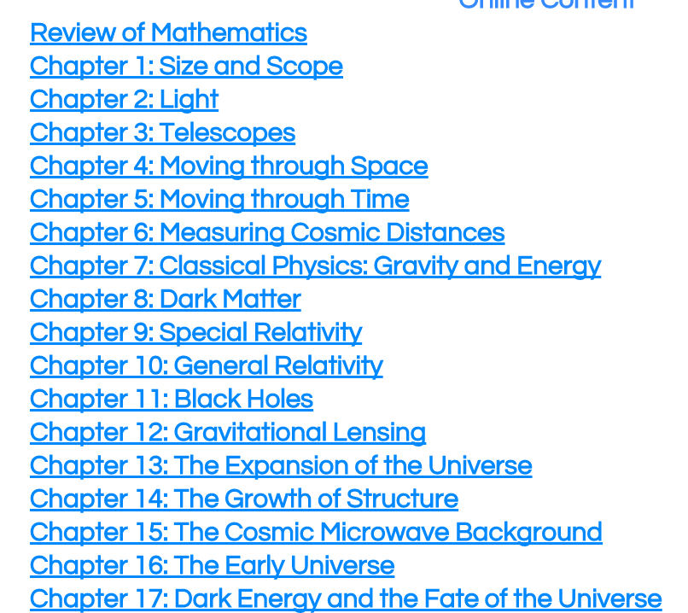
Chapters
Adopting authors can select any combination of chapters
Assessment results from both online and hybrid classes available
*

Slide 24
Chapter Structure
Introductory Video
For each subsection:
  Learning Objectives
  Student dialogue
  Conceptual, numerical and interactive activities
Extensions
  Going Further (astrophysics)
  Math Explorations
Wrapping it Up Activity – synthesizes LOs
Mission Report (submitted for grade)

Slide 25
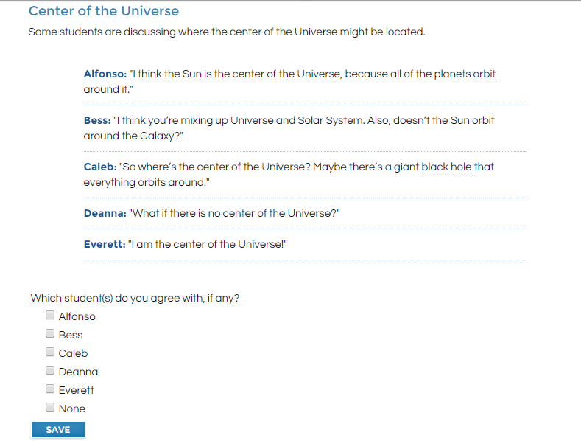
Example Student Dialogue

Slide 26
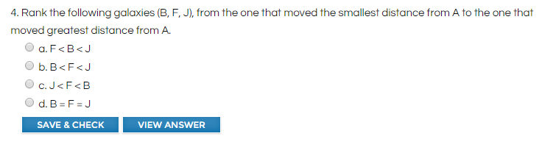
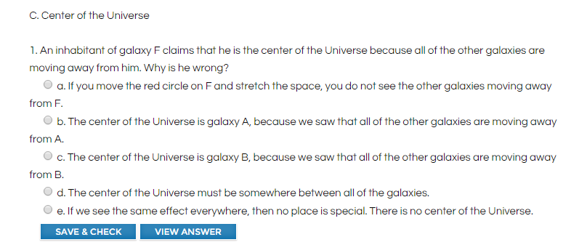
Example Conceptual Problems
To determine the distance a galaxy moved, double click the red version of the galaxy. You will see a green line and be able to read off a distance.

Slide 27
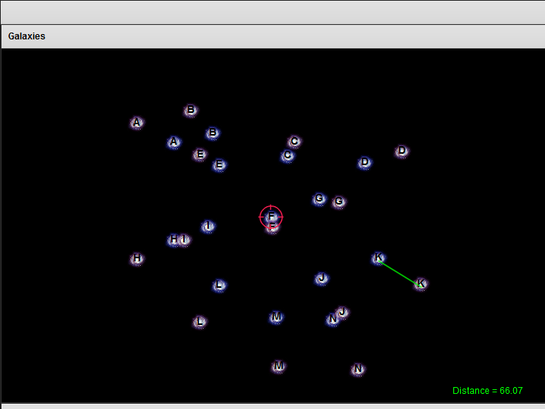
Example Interactive

Slide 28
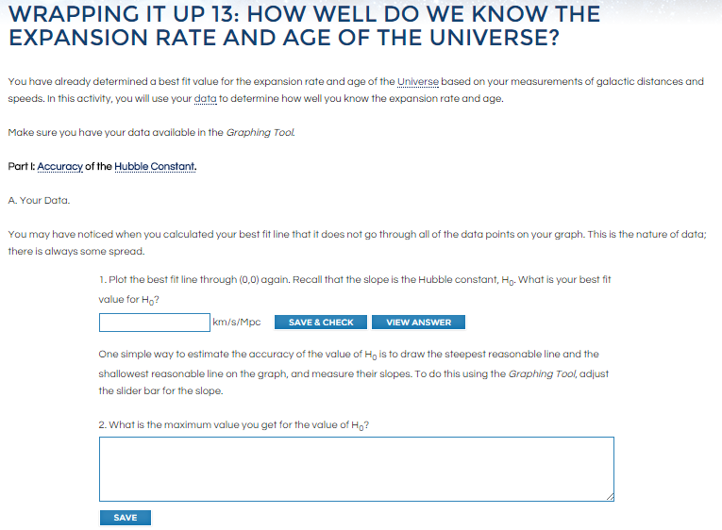
Example Wrapping it Up

Slide 29
To Learn More:
For free review access, write to lynnc@universe.sonoma.edu
Or check out:
http://www.greatriverlearning.com/Cosmology

